Slide 1

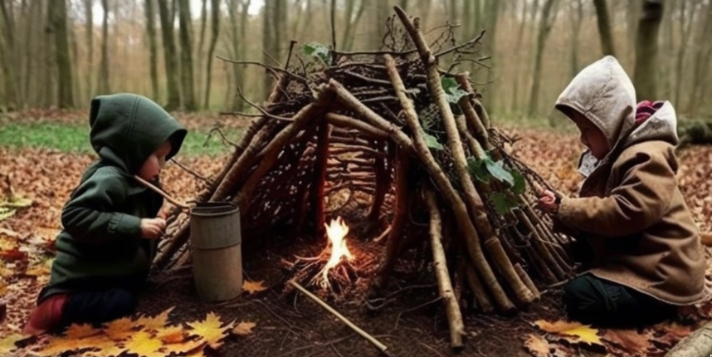


How does cognitive development occurs in three to four-year-old children attending forest schools in London?
(Forest school teacher’s and practitioner’s perspectives)
Sadiya Farooq | MA Early Childhood Studies
University Of Roehampton

Slide 2
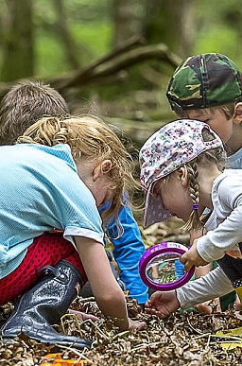
Background
The Forest School approach is an educational method that centres on outdoor, nature-based experiences to promote children’s overall development. Rooted in Scandinavian traditions, it highlights child-initiated play while nurturing a strong relationship with the natural world (Knight, 2016).
Cognitive development encompasses the progression of mental abilities that allow children to think critically, acquire knowledge, retain information, and solve problems (Flavell, 1985)

Slide 3
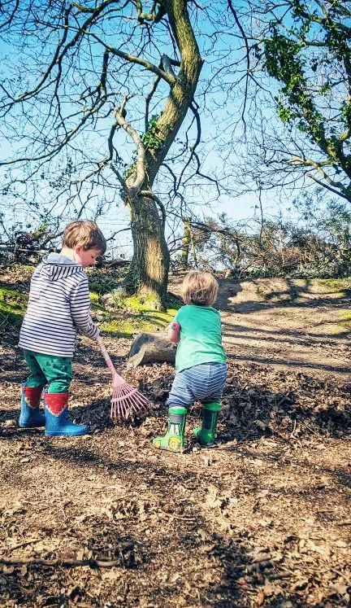
Rationale
1. This research is driven by my strong interest in forest schools and their impact on children’s cognitive development.
2. Images and observations of children engaged in outdoor, nature-based learning inspired my focus on how exploration, creativity, and critical thinking are fostered in such environments (O’Brien & Murray, 2007).
3. Research highlights that forest schools promote child-led play, problem-solving, self-regulation, and resilience, particularly within Scandinavian and UK contexts (Knight, 2016; Bølling et al., 2019).

Slide 4
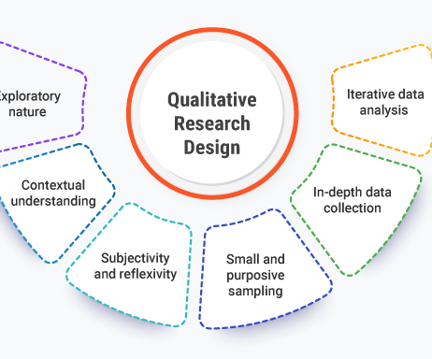
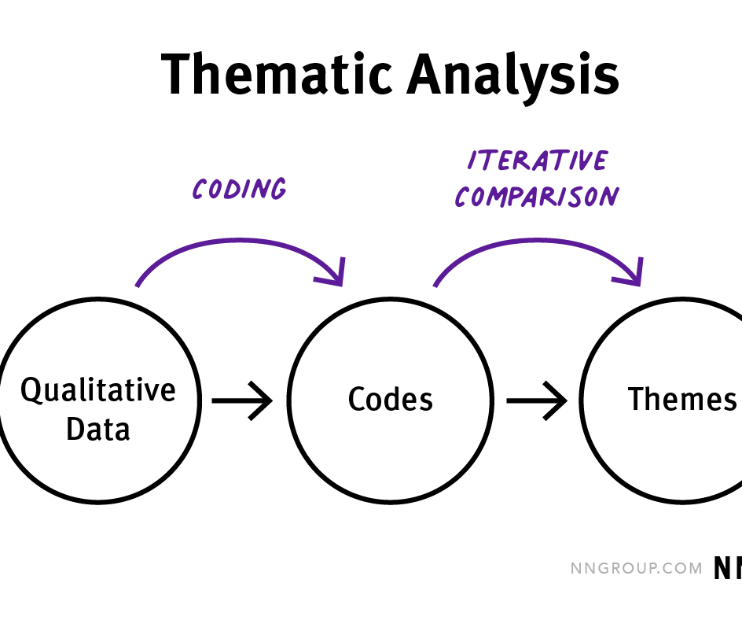
Methodology & Data Analysis
• Qualitative
• Structured interviews
• 6 experienced forest school practitioners
• Thematic analysis

Slide 5
Ethical Consideration
Research followed BERA (2024) guidelines, ensuring integrity, trust, and participant protection.
Informed consent obtained; participation was voluntary with the right to withdraw anytime.
Confidentiality and anonymity maintained (pseudonyms used, GDPR-compliant data storage).
Participants reminded there were no right or wrong answers; interviews conducted respectfully.
Researcher bias mitigated through neutral, reviewed interview design.
Ethics embedded throughout the study, enhancing credibility and societal value.

Slide 6
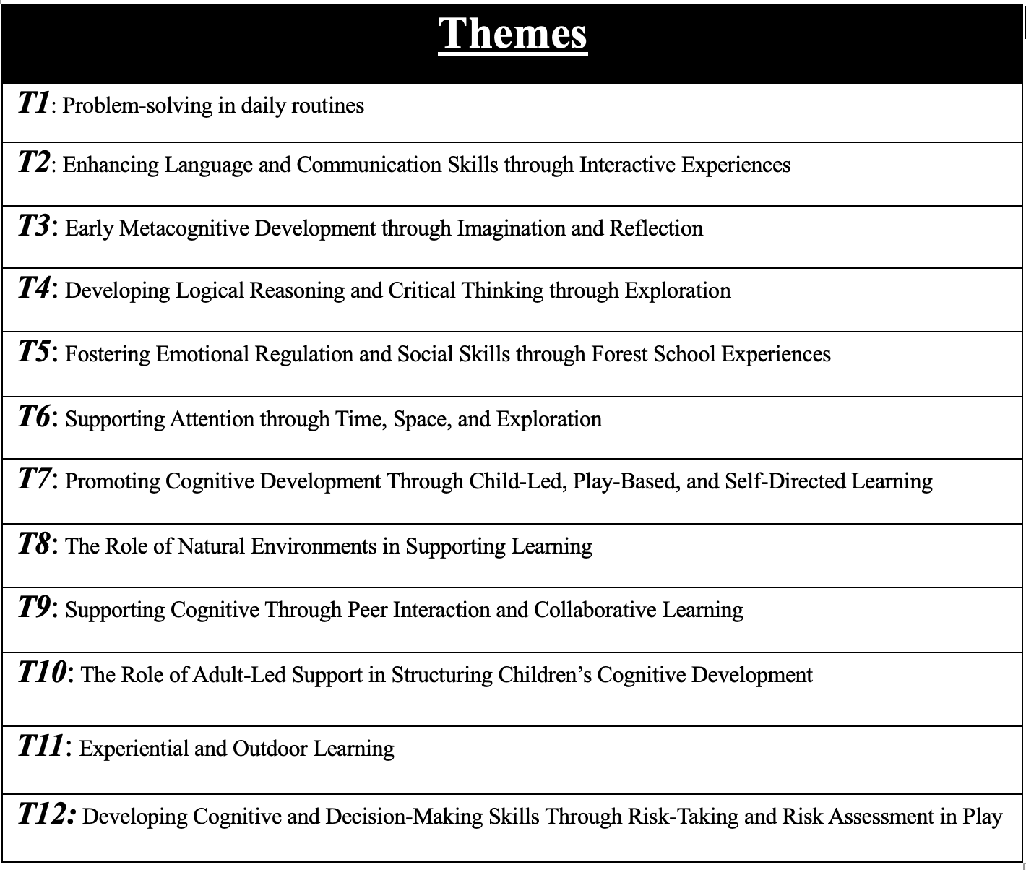
Overview of
Key Findings

Slide 7
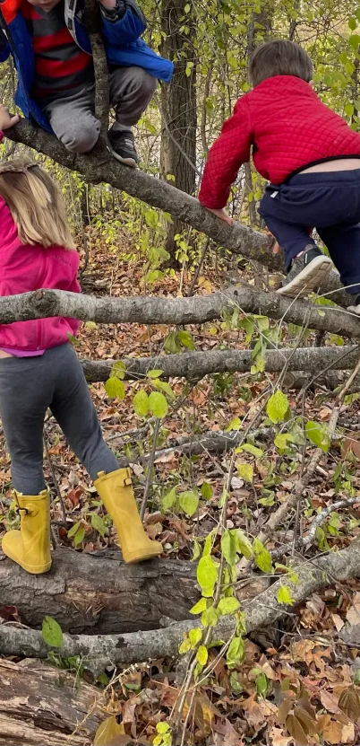
Problem-Solving in Daily Routine
1. Practitioners described problem-solving as embedded in everyday routines, such as deciding 'They don’t want to wear their coat […] then they go outside and see it’s raining […] probably a good idea if I put my coat on’ (P2).
2. These moments reflect experiential learning cycles of action, reflection, and adaptation occurring naturally during play (Kolb, 1984; Knight, 2013).
3. Children engaged in creative and physical experimentation ‘how to make a seesaw with a piece of log’ (P3) or testing ‘what holds and what collapses when balancing on logs or building dens ‘(P6) linking problem-solving with risk-taking and imagination.
4. Social negotiation and conflict during play were viewed as valuable learning opportunities, ‘I think we should play it like this […] I don’t want to play it like that’ (P4),

Slide 8
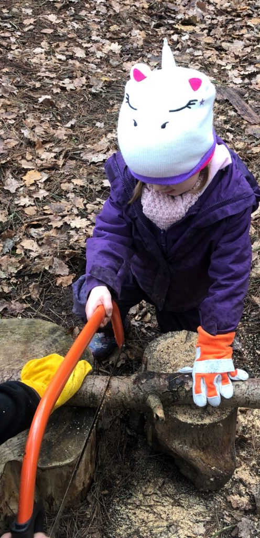
Early Metacognitive Development Through Imagination and Reflection
1. Practitioners observed metacognitive thinking embedded in everyday play, with children verbally explaining actions, reflecting on failures, and adjusting strategies. 'They were able to explain each small part of how they did it (‘I even stood on my tiptoes!’) and then came to the conclusion that combining the different methods they tried might come to a different outcome’ (P1) , ‘Next time I’ll use a bigger stick—it didn’t work with the small one’ (P6).
2. These moments suggest micro-cycles of doing, talking, and revising, rather than formal, adult-led reflection sessions (Kuhn, 2016; Whitebread et al., 2017).
3. Material engagement and tool use supported recall and transfer, with children linking past experiences to current tasks and evaluating outcomes (Gill, 2017). One noted that children, upon seeing tools, would ‘recall on that past knowledge of using’ (P2)
4. Adults supported reflection through brief, dialogic prompts, scaffolding thinking without reducing children’s agency (Vygotsky; Knight, 2013). ‘I want them to question because by then questioning […] it allows them to like, reflect and expand their thinking’ (P3).

Slide 9
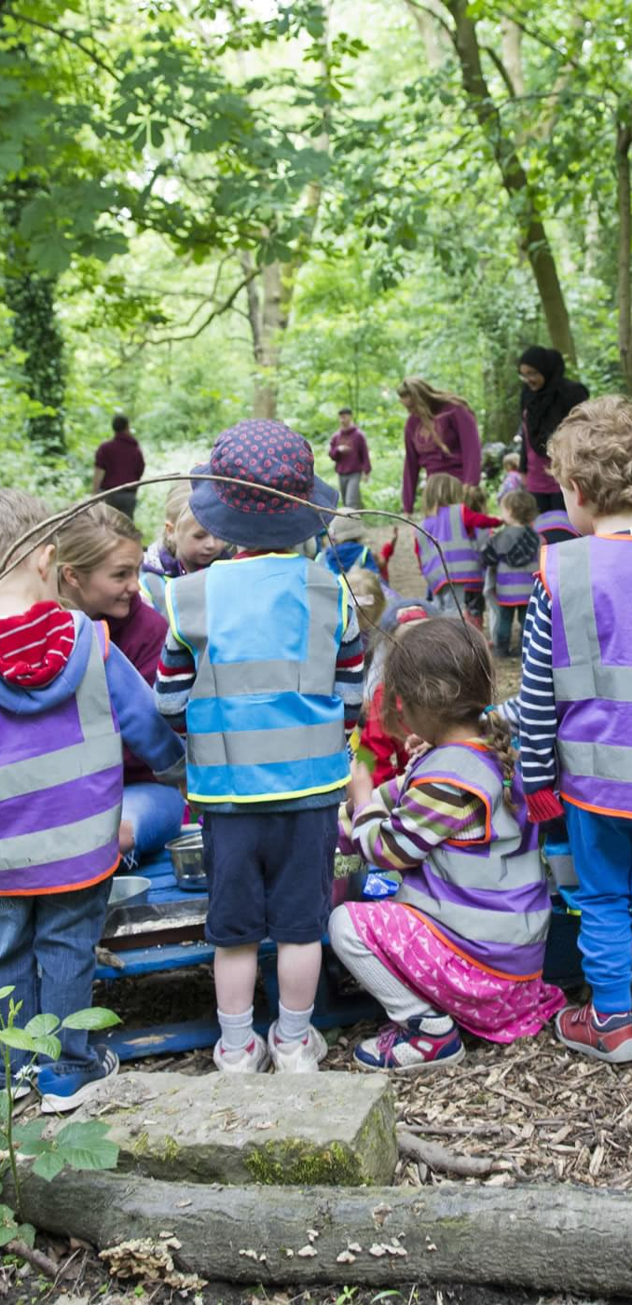
Developing logical Reasoning and Critical Thinking through Exploration
1. Practitioners described reasoning as emerging in action, through questioning, causal talk ‘because […,]’ (P1), ‘why, why, why? Questioning’ (P3), prediction, and dialogue during play.
2. Reasoning often unfolded through social play plus light-touch adult scaffolding. The cheese is all gone now’ (P1) after adult input about allergy.
3. Children used causal and pattern-based explanations in everyday observations and semi-structured tasks, ‘puddles disappeared because the sun’s shining’ (P5) and in semi-structured tasks ‘decide the order of beads’ (P6).
4. Children’s logical reasoning in forest schools is woven through ‘questioning’ (P1, P3, P4), ‘negotiation’ (P2), ‘observation’ (P5) and planning/sequencing (P6).

Slide 10
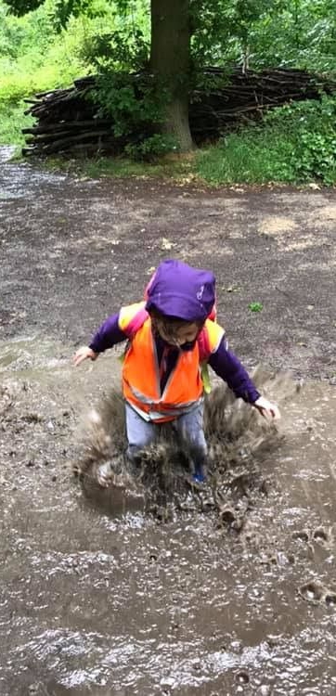
Supporting attention though time , space, and Exploration
1. Practitioners described attention as emerging from a balance of autonomy, structure, and sensory-rich experiences, rather than from nature alone. ‘explore camp and each activity as much or as little as they like’ (P1).
2. Child-led exploration and temporal flexibility supported sustained focus, with children engaging in imaginative play for extended periods (Robson, 2019). Turning a piece of rope into a bus or a train and playing with it for 30–40 minutes’ (P4).
3. Rules and routines, especially during higher-risk activities, enhanced attention when children understood the purpose behind them, supporting self-regulation (Vygotsky, 1978). ‘Listen to the rules of the tool but also to understand why the tool is dangerous and its intended purpose’ (P2; P3).
4. Natural calm and sensory engagement helps in sustaining attention. Activities such as ‘bug hunting, mud play, or collecting natural treasures were noted as those that tend to hold their focus best’ (P6).

Slide 11
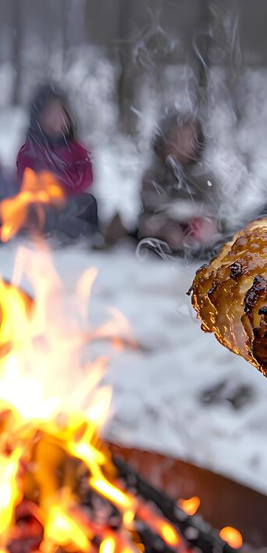
Decision Making Skills through Risk Taking
1. Practitioners viewed risk as cognitively generative, predicting outcomes, and adjusting behaviour—not just thrill or hazard. ‘Risk is ‘part of everything that we do […] a physical challenge […] a tightrope or a swing’ (P2); everyday tasks such as ‘cooking bread over fire’ (P3).
2. These encounters supported real-time decision-making and flexible thinking.
3. Adult scaffolding legitimised and contained risk, creating safe boundaries while enabling challenge (Knight, 2013).

Slide 12

Interconnected Development: Cognitive and Beyond
Enhancing Language and Communication Skills through Interactive Experiences
Fostering Emotional Regulation and Social Skills through Forest School Experiences
The Role of Natural Environments in Supporting Learning

Slide 13

Conclusion
By centring practitioner perspectives/voice, this research produces findings that are not only academically grounded but also authentic, credible, and directly relevant to real-world practice.

Slide 14
Thank You

