Slide 1
Exploring the impacts of ECS degrees on professional identity development – a work in progress
Kerry Holman
Kerry.holman@canterbury.ac.uk

Slide 2
This presentation…
A whistlestop tour!
- Background to the study
- Where am I at so far?
- Headlines from the data analysis
- What next?

Slide 3
About the study
My EdD final research project which began in 2023
Exploring the experiences of three ECS alumni – their undergraduate HE experiences and how they are shaping their professional identity development
Using interpretative phenomenological analysis hence the small sample size – all three participants completed ECS degree at the same time, and all three attended a national conference with me where they presented collaborative projects they had done with children
Interviewed them informally in 2024 once they had completed their degrees, and again one year on in Summer 2025
Submission in October 2026 hopefully…

Slide 4
Where is the project at?
First interviews undertaken at graduation in Summer 2024
Interviews were recorded, transcribed and analysed following an amended IPA step process
Data analysis complete
Analysis between participants, and between the two sets of interviews highlighting divergences and convergences in the data
Discussion chapter is currently in progress, identifying implications for practice at HE level and wider ECEC sector level
Second interviews in Summer 2025

Slide 5
Upon degree completion… Summer 2024
‘I think that I can do that’
‘I feel empowered’
‘I don’t have to rely on everyone else’

Slide 6
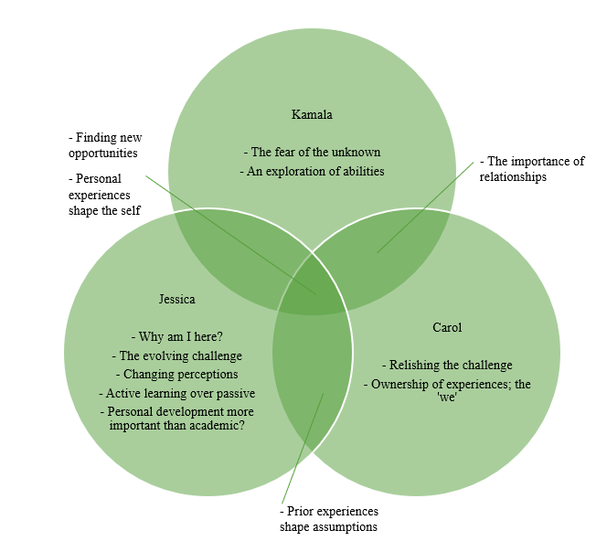
Upon degree completion 2024
Convergences and divergences in the key experiential themes identified through the data analysis

Slide 7
Upon degree completion… Summer 2024
“And in in that (interview), I was asking them questions about how they empower children's voices through… it's it's a diagnostics psychology ward, and that was my question to them. And when I tell you that his jaw hit the floor, he was a bit like…He was... I wasn't expecting you to ask me that. I was like, well, I wanna know!!”
“And I do feel more confident going forward. And I was umming and ahhing about what to do when I came to the end of the uni, I wasn't really sure. And that sort of stuff. But I was always worried about doing social work because, one thing is the stigma attached to it mainly, let's be honest. And two, the importance of making sure that you can connect with the child and you can…”
“It was kind of, it was really like, exciting 'cause…. One of the interviews I went for was for, I think it was the virtual schools one so it's like organising events for foster children and adopted children and children and families who foster and things like that. And it was like the way they were like, oh, could you do this? And I was like, actually, I did this, this and this, and it was quite nice to have that something that I can go oh, actually, I'm not just completely novice”

Slide 8
A year on from graduation… Summer 2025
‘I can do these things’ – now an MA student in Social Work
‘I feel proud, important’ – now a neurodevelopmental practitioner with further post-graduate study offered
‘I was that safe space’ – now working in an SEN secondary school class

Slide 9
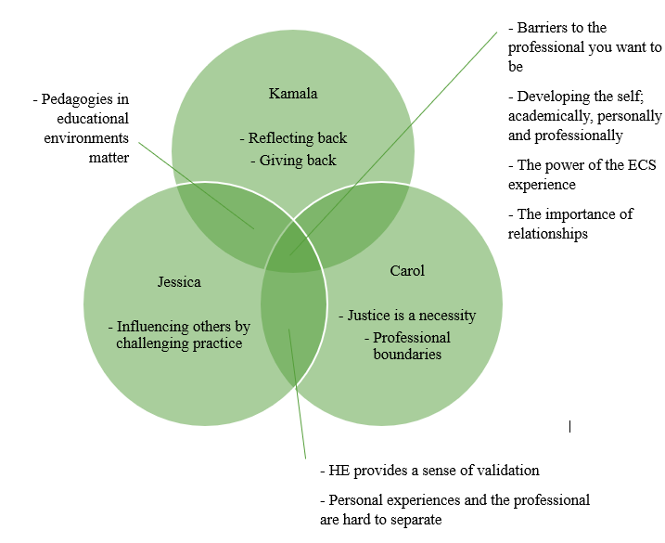
A year on from graduation… Summer 2025
Convergences and divergences in the key experiential themes identified through the data analysis
There was a shift in the use of reflection between 2024 and 2025, with all three using reflection much more critically when considering their professional identities one year on…

Slide 10
What are the key themes to emerge?
The data analysis in my study has reiterated the fact that academic development and personal development are necessary to enable professional identity to develop…
Academic development – being heard
Personal development – being confident
Together…
Professional identity development happens – becoming and belonging as the expert
Part of my contribution to knowledge from this work is a new conceptual model to highlight how these elements intertwine, resulting from my data analysis

Slide 11
Tentative conclusions
To support graduate professional identity development, the study has highlighted implications for practice at the local level, the national HE level and the wider sector level more broadly:
- A newly validated ECS degree at the local level, informed by some of the findings from this study
- More opportunities for experiential learning at the national HE level, with time and space for reflection and a continued move away from more traditional methods of teaching
- Continued professional development at the wider sector level – participants in this study often felt in silo much of the time in their working capacities

Slide 12
Questions?
For you…
- suggestions for journals which my work could fit within?
- what could dissemination of this work look like?
For me?
Thank you.

