Slide 1
A Mosaic Of Voices: Exploring Risk And Resilience In Forest School
Evangeline Jesse Godwin
Canterbury Christ Church University

Slide 2
Introduction
Risk is a small word that carries big fear - especially when it comes to young children
In early childhood settings, it is often something to be avoided rather than understood. Many educators prioritise protection over exploration (Connolly & Haughton, 2015; Spencer, 2021).
Growing evidence suggests the opposite: Overprotection may cause more harm than good, limiting children’s autonomy, confidence, and resilience (UNICEF, 2025; Gill, 2015; Garden, 2022).
This tension is particularly visible in Forest School contexts - where the benefits are well established, but risk is still approached with hesitation, often wrapped in cotton wool.
Forest School aims to support learning through meaningful engagement with risk, yet decisions about risk are rarely made by children alone.

Slide 3
Introduction
Instead, risk is shaped by a network of adult influences—parents, practitioners, managers, and wider cultural discourses around safety and accountability.
Existing research typically explores children’s experiences or adult perspectives in isolation, missing how these views interact in everyday practice.
This disconnect creates uncertainty around how risk is negotiated in Forest School settings, potentially diluting its intended benefits.
When risk is negotiated without children, Forest School risks losing the very learning it was designed to protect.

Slide 4
Context And Research Question
Early childhood is shaped by two competing narratives: risk as danger versus risk as necessary for growth.
In Forest School, children’s engagement with risk is shaped by a wider ecological systems - parents, practitioners, leaders, and cultural expectations.
While risk is central to Forest School pedagogy, it is often co-constructed by adults, with children’s voices unevenly represented.
This study explores how risk is perceived, negotiated, and enacted within these relationships, and how this shapes children’s resilience and agency.

Slide 5
Context And Research Question
Central Question: How is risk perceived, enacted, and influenced in Forest School, and how does it contribute to the development of resilience and agency in young children?
How do children, practitioners, parents, and leaders define and approach risk?
What factors within their ecological systems shape these attitudes and decisions about risk?
How is risk co-constructed in Forest School through the interactions between children and adults?
In what ways does engaging with risk contribute to the development of resilience and agency in young children?
How can insights from these perspectives inform practices that support safe, meaningful, and child-led risk-taking in early years settings?

Slide 6
Literature Review
1. Risk as Learning
2. Cultural Tension
Risk is a negotiable, perceptible challenge that supports learning when children can choose how to engage (Sandseter, 2007; Nikiforidou, 2018)
Childhood is shaped by a risk-averse culture prioritising protection and accountability
(Beck, 1992; Gill, 2007)
3. The Protection Paradox
4. Resilience & Agency
Overprotection limits opportunities for competence, autonomy, and resilience
(Lester & Russell, 2008; Brussoni et al., 2015)
Resilience develops through everyday challenge; Agency grows when children author their engagement with risk (Masten, 2014; Ungar, 2011; Lansdown, 2019)

Slide 7
Literature Review
5. Forest School Reality
6. The Gap
Supported risk-taking is central in principle, but often constrained in practice by adult and institutional pressures (Connolly & Haughton, 2015)
Research rarely examines how children’s and adults’ perspectives intersect in negotiating risk. The relational process of risk remains underexplored
To understand how risk supports resilience and agency, we must look beyond outcomes and examine how risk is negotiated with children—relationally, across adults, institutions, and
the systems that shape their choices.

Slide 8
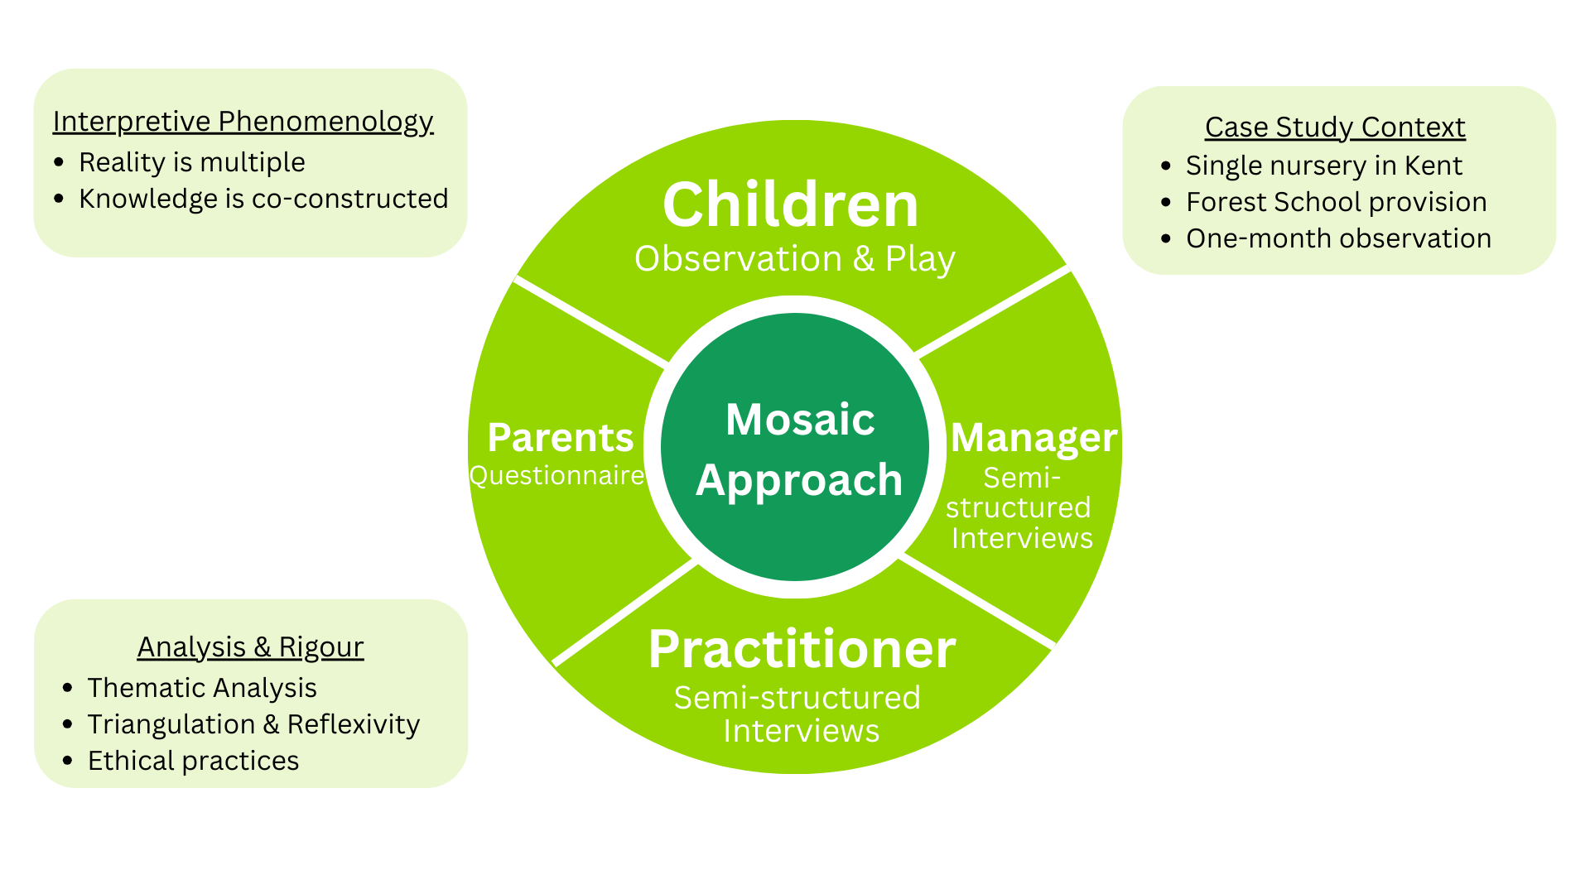
Methodology

Slide 9
Methodology: Sampling
This study adopted a purposive sampling strategy, consistent with its qualitative and interpretive orientation.
The sample comprised six children, four practitioners, five parents, and one nursery manager.
While modest in size, it was purposefully designed to prioritise depth of understanding over breadth, consistent with the study’s case study and phenomenological orientation (Turtle, Convery & Convery, 2015).
The goal was not to generate generalisable findings but to offer contextualised insights that may hold transferability to similar early years and Forest School settings.

Slide 10
Parents’ Perspective
Risk as growth
& learning
Conditional Support
FS as a safe context
Hesitancy & injury awareness
Risk – Resilience & Independence
Transferable life skills
Minor injuries framed
as learning
Comfort tied to adult supervision
Trust in practitioners expertise
Provides structured, supported environment
Children gain confidence in nature & novel experiences
Perceived “safe risk” encourages exploration
Minor injury accepted, serious harm raised concern
Request for clarity
about safety decisions

Slide 11
Practitioners’ Perspective
Experience as lens
Individuality & institution
Stepping back to
grow autonomy
Leading by example
Personal history shape
risk tolerance
Childhood experiences influence confidence
and fear
Risk viewed as essential
Navigate rules vs. situational judgement
Acceptable vs. unacceptable risk
Gradual release from support
Modelling + boundary-setting = confidence building
Facilitating independence while ensuring safety
Demonstrating composure and courage in risky play
Role-modelling for children and influencing team norms

Slide 12
Managers’ Perspective
FS AS AN ETHOS
Language & modelling
Institutionalising supported risk
Balancing parents, culture & institution
FS ethos extends beyond outdoor play
Risk seen as developmental necessity for all children
Enhances independence and mental health
Practitioner language and behaviour shape attitudes towards risk
Modelling composure and confidence legitimise risk-taking
Practitioners evolve alongside children
Training, reflective tools and risk benefit assessments
Accident forms used as learning opportunities
Clear boundaries against serious bodily harm
Managers navigate parental worries through clear communication
Differentiate between anxious and permissive parents
Align safeguarding with FS values

Slide 13
Children's Perspective
Risk as thrill & enjoyment
Confidence through repetition
Negotiating agency & independence
Ecosystem of influence
Risk seen as fun and exciting adventure
‘Flying in the clouds’ imaginative reframing
Children encourages peers and celebrated attempts
Repeated tricky play built mastery
Encouragement and shared routines ritualised risk
Resilience grew through challenges
Choosing when to ask for help or try alone
Peers offered encouragement and assistance
Adapted strategies to manage challenges
Children’s views echoed both adventurous FS ethos and adult safety messages shaped by Brofenbrenner’s Ecological Systems Theory

Slide 14
Discussion: Risk, Resilience & Agency as Relational
Risk-taking in Forest School is negotiated, not individual (shaped by children, parents, practitioners, and leadership)
Children’s agency emerged within relationships of trust, not through unrestricted independence
Resilience functioned as adaptation with support, rather than “bouncing back” alone (Ungar, 2011)
Adult responses (scaffolding, language, boundaries) directly shaped children’s confidence
Findings align with Bronfenbrenner’s ecological systems theory: development occurs across interconnected systems
Challenges deficit views of resilience as an innate trait

Slide 15
Discussion: Forest School Ethos, Space & Systemic Tensions
Forest School environments naturally afford risk (uneven ground, height, loose parts)
and risk emerges through interaction with space (Gibson, 1979)
Ethos was as influential as environment: child-led practice + supported risk = meaningful agency
Practitioner facilitation (stepping back, modelling calm) enabled children to extend capabilities
Inconsistent adult thresholds risk fragmented messages for children
Leadership was critical in legitimising risk within safeguarding frameworks
Risk of commodification: Forest School reduced to aesthetics rather than pedagogy (Leather, 2018)
Embedding ethos across indoor and outdoor contexts strengthens transfer of resilience and agency

Slide 16
Conclusion
Risk in Forest School is understood and enacted differently by children, parents, practitioners, and leadership
Children experienced risk as adventure, creativity, and possibility, not danger
Risk-taking was co-constructed through relationships, not taken in isolation
Resilience is best cultivated through systems, spaces, and relationships, not individual grit
Agency was expressed through decision-making, problem-solving, asking for help, imaginative reframing of outcomes
Findings affirm ecological and social models of development (Bronfenbrenner, Ungar, Vygotsky, Gibson)

Slide 17
Conclusion
Forest School’s impact lies in its ethos, not its aesthetics
Risk should be embedded as everyday pedagogy, not an “add-on”
Consistency across systems (home, practitioners, leadership) prevents mixed messages for children
Leadership plays a critical role in legitimising supported risk, balancing safeguarding with agency, resisting commodification
Parental engagement is key - shared understanding builds trust
Forest School offers a model of early years practice that: values uncertainty as learning, safeguards without overprotection, positions children as active agents in their development

Slide 18
References
Beck, U. (1992) Risk society: Towards a new modernity. London: Sage. Available at: http://www.riversimulator.org/Resources/Anthropology/RiskSociety/RiskSocietyTowardsAnewModernity1992Beck.pdf (Accessed: 07 August 2025).
Brussoni, M., Olsen, L.L., Pike, I. and Sleet, D.A. (2012) ‘Risky play and children’s safety: Balancing priorities for optimal child development’, International Journal of Environmental Research and Public Health, 9(9), pp. 3134–3148. Available at: https://doi.org/10.3390/ijerph9093134
Connolly, M. and Haughton, C. (2015) ‘The perception, management and performance of risk amongst Forest School educators’, British Journal of Sociology of Education, 38(1), pp. 105–124. Available at: https://doi.org/10.1080/01425692.2015.1073098
Garden, A. (2022) ‘Reimagining learning: Power, risk, and place in Forest Schools’, PRISM: Casting New Light on Learning, Theory & Practice. Available at: https://www.researchgate.net/publication/389044515_Reimagining_Learning_Power_Risk_and_Place_in_Forest_Schools (Accessed: 14 August 2025).
Gill, T. (2015) ‘Playing it safe? A global white paper on risk, play and children’s well-being’, International Journal of Play, 4(1), pp. 3–25. Available at: https://vanleerfoundation.org/wp-content/uploads/2018/05/White-paper_Playing-it-safe_Tim-Gill_May-2018.pdf (Accessed: 25 August 2025).
Gill, T. (2007) No fear: Growing up in a risk averse society. London: Calouste Gulbenkian Foundation. Available at: https://rethinkingchildhood.com/wp-content/uploads/2010/10/no-fear-19-12-07.pdf (Accessed: 12 August 2025).

Slide 19
References
Lansdown, G. (2018) Children’s participation in the work of national human rights institutions (NHRI Series: Tools to Support Child Friendly Practices). UNICEF Europe and Central Asia Regional Office. Available at: https://www.unicef.org/eca/sites/unicef.org.eca/files/2019-02/NHRI_Participation.pdf (Accessed: 27 August 2025).
Leather, M. (2018) ‘A critique of Forest School: Something lost in translation’, Journal of Outdoor and Environmental Education, 21(1), pp. 5–18. Available at: https://doi.org/10.1007/s42322-017-0006-1
Lester, S. and Russell, W. (2008) Play for a change: Play, policy and practice: A review of contemporary perspectives. London: National Children’s Bureau. Available at: https://www.researchgate.net/publication/263087151_Play_for_a_Change_Play_Policy_Practice_A_Review_of_Contemporary_Perspectives (Accessed: 27 August 2025).
Masten, A.S. (2014) ‘Global perspectives on resilience in children and youth’, Child Development, 85(1), pp. 6–20. Available at: https://doi.org/10.1111/cdev.12205
Nikiforidou, Z. (2017) ‘Risk literacy: Concepts and pedagogical implications for early childhood education’, Contemporary Issues in Early Childhood, 18(3), pp. 322–332. Available at: https://doi.org/10.1177/1463949117731027
Sandseter, E.B.H. (2007) ‘Categorising risky play—how can we identify risk-taking in children’s play?’, European Early Childhood Education Research Journal, 15(2), pp. 237–252. Available at: https://doi.org/10.1080/13502930701321733

Slide 20
References
Spencer, R.A. (2021) ‘Early childhood educator perceptions of risky play in an early childhood context’, Early Childhood Education Journal, 49, pp. 111–123. Available at: https://www.ncbi.nlm.nih.gov/pmc/articles/PMC8116185/ (Accessed: 14 August 2025).
Turtle, C., Convery, I. and Convery, K. (2015) ‘Forest Schools and environmental attitudes: A case study of children aged 8–11 years’, Cogent Education, 2(1). Available at: https://doi.org/10.1080/2331186X.2015.1100103
Ungar, M. (2011) The social ecology of resilience: A handbook of theory and practice. New York: Springer.
UNICEF (2025) ‘The importance of outdoor play (and how to support it)’. Available at: https://www.unicef.org/eca/stories/importance-outdoor-play-and-how-support-it (Accessed: 14 August 2025).

Slide 21
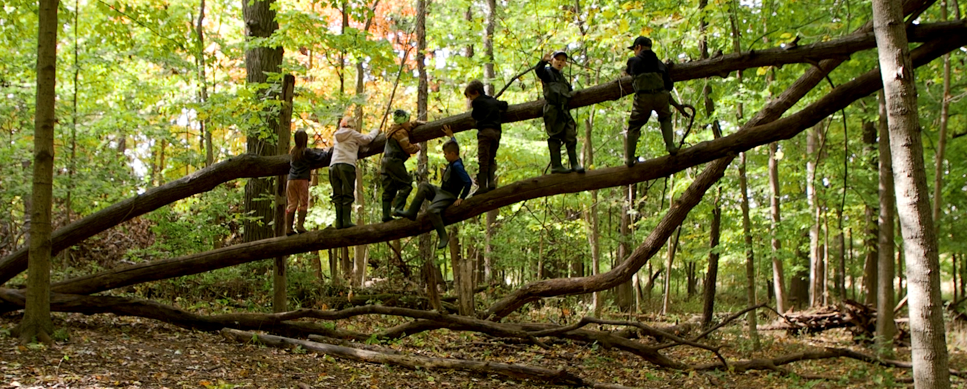
Thank you.
Contact: Evangeline.jesse03@gmail.com

