Slide 1

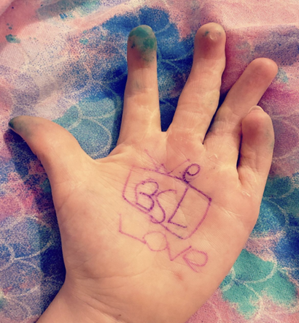
Impact of Deaf Representation in Literature on Deaf Identity
Exploring literature’s role in shaping cultural awareness

Slide 2
Introduction and Background

Slide 3

Aim of the Research
Research Focus
  The study explores how deaf representation in children's literature shapes Deaf identity development.
Importance of Representation
  Accurate representation fosters positive identity and belonging among Deaf children, while misrepresentation harms self-esteem.
Cultural vs Medical Models
  Research examines if portrayals reflect cultural realities or adhere to a medical model framing deafness as a condition.
Implications for Inclusion
  Findings aim to guide authors, educators, and policymakers towards more inclusive and empowering narratives.

Slide 4
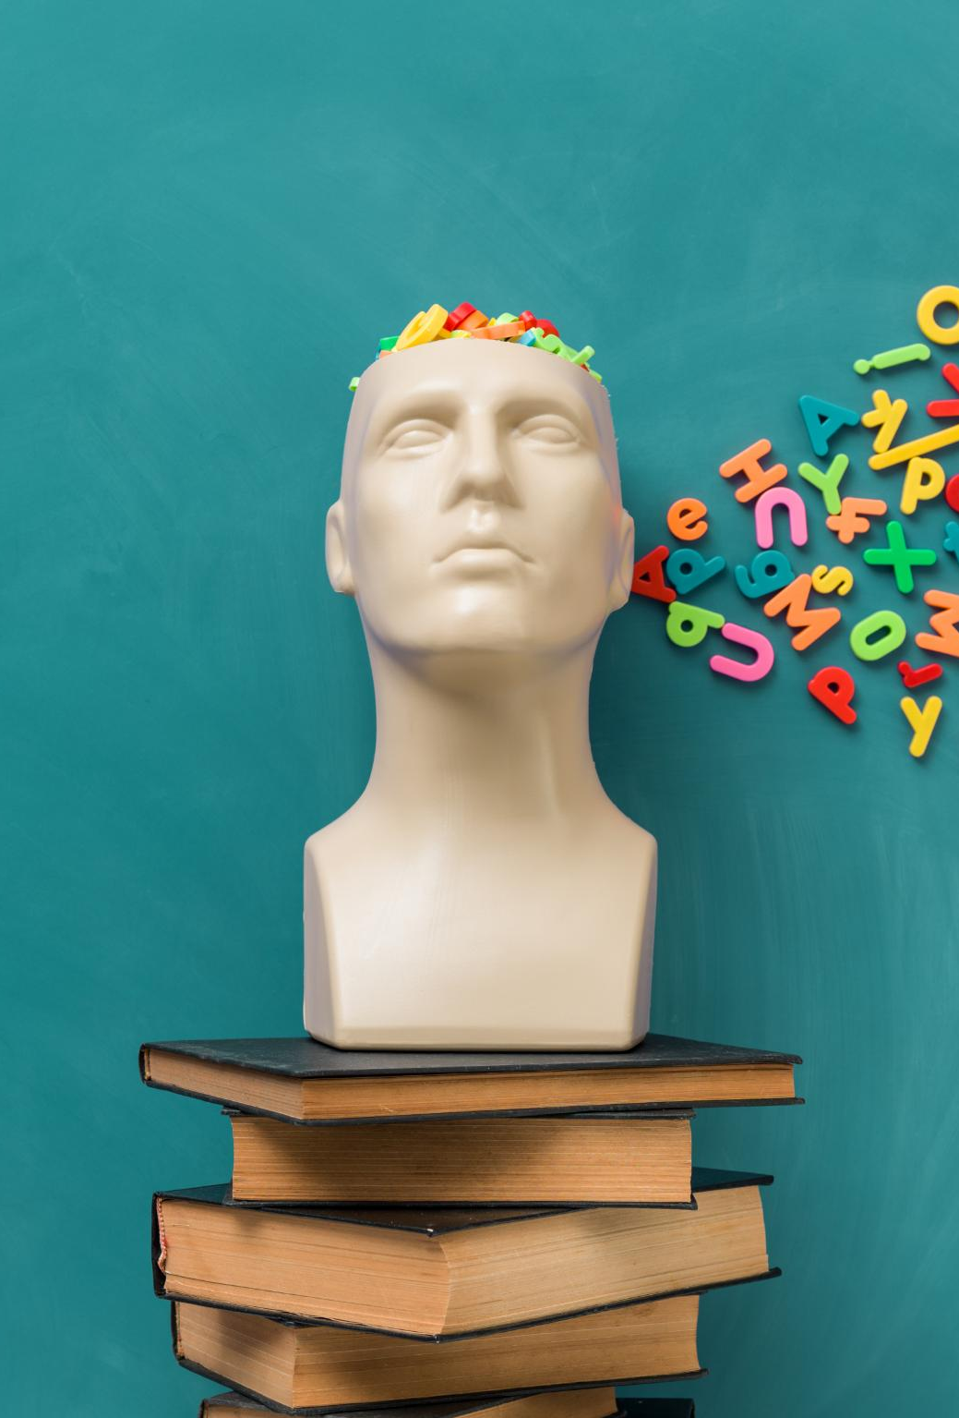
Why This Research Matters
Challenges Faced by Deaf Children
  Most deaf children are born to hearing parents, limiting exposure to Deaf culture and role models, causing identity struggles (NDCS, 2021).
Impact of Literature Representation
  Literature shapes children's self-perception; medical portrayals of deafness can undermine positive identity development (Ayala, 2010;).
Mental Health Risks
  Deaf children in mainstream settings face higher mental health risks due to limited peer access and cultural affirmation (Wolters et al. ., 2011).
Goal of Inclusive Literature
  This research aims to improve understanding of how inclusive literature supports well-being and identity in deaf children.

Slide 5
Literature Review

Slide 6

Identity Development in Deaf Children
Deaf Identity Categories
  Deaf identity includes culturally Deaf, culturally hearing, bicultural, and marginal categories influenced by social interactions (Bat-Chava, 2000; Chapman & Dammeyer, 2017).
Influences on Identity Development
  Parental hearing status, communication methods, educational settings, and exposure to Deaf culture shape identity development (Leigh, 2009).
Role of Affirming Literature
  Accurate and affirming representation in books helps deaf children navigate identity and reduce feelings of isolation (Style, 1996; Lane, 2022).

Slide 7
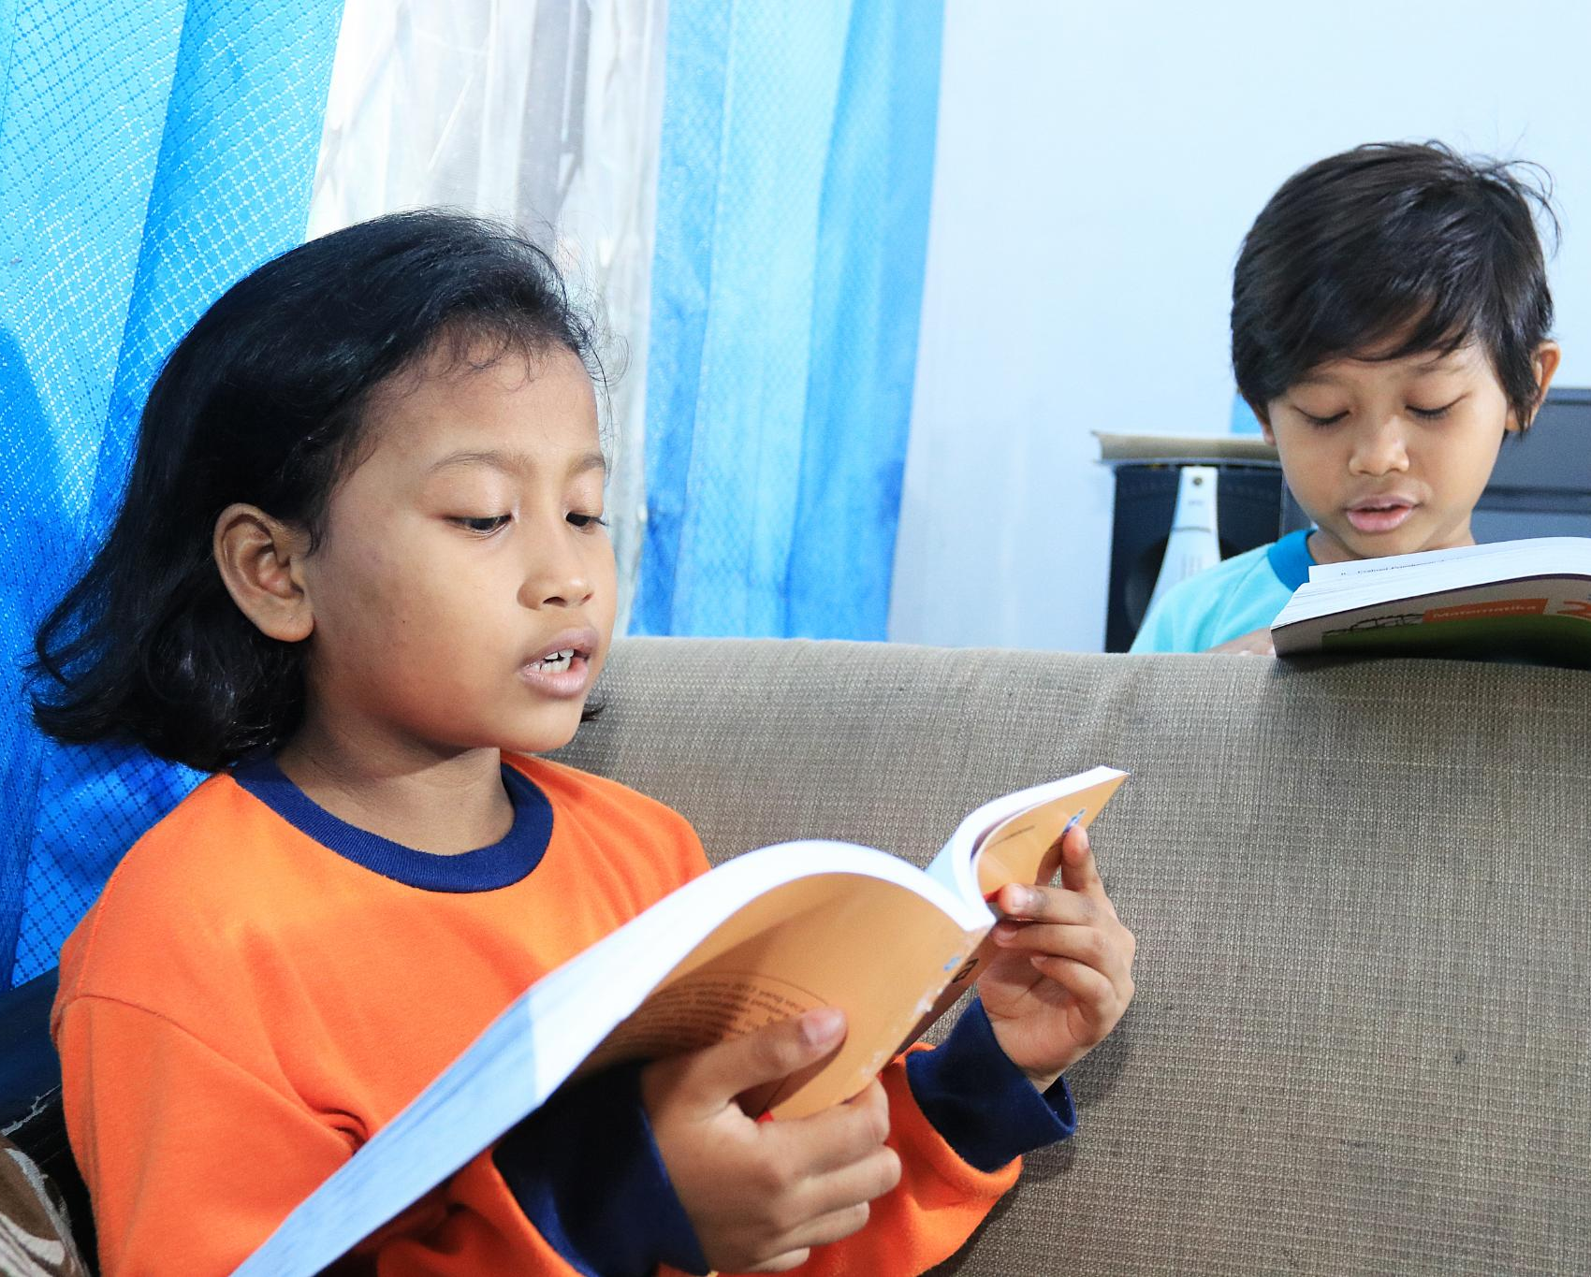
Representation of Deaf Characters in Literature
Increasing Inclusion of Deaf Characters
  Children's literature has more deaf characters, but quality and authenticity often remain inadequate (Golos & Moses, 2011).
Medical Model vs Cultural Identity
  Many portrayals focus on medical aspects like hearing aids rather than celebrating Deaf culture and sign language (Pajka-West, 2007).
Importance of Authentic Representation
  Lack of authentic Deaf voices in authorship leads to stereotypes and misconceptions in literature (Bailes 2009).
Impact on Deaf Children's Identity
  Accurate cultural narratives in literature influence deaf children's self-perception and societal attitudes positively (Beckett, 2009).

Slide 8

Impact on Children’s Identity and Well-being
Influence on Deaf Children's Identity
  Portrayals emphasizing limitations can lower self-esteem and cause identity confusion among deaf children (Zaks, 2024).
Empowerment Through Representation
  Accurate cultural representation in literature fosters pride, resilience, and empowerment in deaf children (Burnbury, 2019).
Mental Health Challenges
  Deaf children face higher risks of mental health issues due to isolation and lack of cultural affirmation (NDCS, 2017).
Benefits of Inclusive Literature
  Inclusive stories provide role models, validate experiences, and promote empathy among all children .

Slide 9
Methodology and Ethics

Slide 10

Research Approach and Design
Qualitative Research Design
  The study uses qualitative methods to explore in-depth individual perspectives on literature representation among deaf children.
Focus Groups Methodology
  Focus groups facilitate collaborative discussion, idea sharing, and the emergence of shared meanings among participants (Masciantonio et al., 2018; Mukherji & Albon, 2023).
Participant Selection
  Purposeful sampling targets Deaf children aged 10 to 11 from a specialist total communication educational setting (Black, 2010).
Interpretivist Paradigm
  The interpretivist framework emphasizes understanding social realities through interaction and supports flexible, emergent themes (Myers, 2019).

Slide 11

Ethical Considerations in Research with Children
Informed Consent
  Consent is secured from both children and parents, respecting children’s autonomy in the research process (Christensen & James, 2017; BERA, 2024).
Confidentiality and Data Security
  Participants’ anonymity is protected and data is stored securely on password-protected devices as per data laws (DfE, 2023).
Child-Friendly Environment
  Research settings minimize stress and promote comfort to support children’s well-being during participation (Harcourt et al., 2011).
Safeguarding and Support
  Measures are in place to handle emotional distress, providing necessary support services to participants (Mukherji & Albon, 2023).

Slide 12
Conclusion and Implications

Slide 13

Summary of Findings and Future Directions
Representation Gap
  Current children’s books often misrepresent deaf characters by focusing on medical aspects over cultural identity.
Impact on Deaf Children
  Misrepresentation affects deaf children’s self-concept and mental health, especially without cultural exposure.
Research and Insights
  Focus groups amplify deaf children’s voices to understand literature’s role in shaping their identity.
Future Directions
  Collaborate with deaf authors and illustrators to create authentic, inclusive educational resources.

Slide 14
References
Ayala, E. C. (1999) ‘“Poor little things” and “Brave little souls”: The portrayal of individuals with disabilities in children’s literature’, Reading Research and Instruction, 39(1), pp. 103–117. Available at: https://doi.org/10.1080/19388079909558314
Bailes, N. (2002) ‘Mandy: A Critical Look at the Portrayal of a Deaf Character in Children’s Literature’, Multicultural Perspectives, 4(4), pp. 3–9. Available at: https://doi.org/10.1207/S15327892MCP0404_2
Bat-Chava, Y. (2000) Diversity of deaf identities. American annals of the deaf, 145(5), pp.420-428.
Beckett, A., Ellison, N., Barrett, S., & Shah, S. (2010) ‘‘Away with the fairies?’ Disability within primary‐age children’s literature’. Disability & Society, 25(3), pp. 373–386. Available at: https://doi.org/10.1080/09687591003701355
British Educational Research Association. (2024) Ethical Guidelines for Educational Research. Fifth Edition.
Black, K. (2010) Business Statistics: Contemporary Decision Making, 6th Edition. London: John Wiley and Sons.
Bunbury, S. (2019) ‘Unconscious Bias and the Medical Model: How the Social Model May Hold the Key to Transformative Thinking about Disability Discrimination’, International Journal of Discrimination and the Law 19(1). Pp. 26–47. Available at: https://doi.org/10.1177
Christensen, P. and James, A. (2017) Research with children, pp. 1-8. Oxfordshire: Taylor & Francis.
Department for Education. (2023) Working Together to Safeguard Children 2023. A guide to multi-agency working to help, protect and promote the welfare of children. Available at: https://assets.publishing.service.gov.uk/media/669e7501ab418ab055592a7b/Working_together_to_
safeguard_children_2023.pdf
Golos, D. B., Moses, A. and Wolbers, K. A. (2012). ‘Culture or Disability? Examining Deaf Characters in Children’s Book Illustrations’, Early Childhood Education Journal, 40 (4), pp. 239-249. doi: 10.1007/s10643-012-0506-0.
Harcourt, D. Perry, B, and Waller, T. (2011) Researching Young Children’s Perspectives: Debating the Ethics and Dilemmas of Educational Research with Children. Abingdon: Routledge.
Lane, M. (2003) ‘Interface fracture’, Annual Review of Materials Research, 33(1), pp.29-54.
Leigh, I. (2009) A lens on deaf identities. Oxford University Press, USA.
Masciantonio, S., Hermer, S.R. and Chur-Hansen, A. (2018) ‘Attachment, mothering and mental illness: Mother-infant therapy in an institutional context’, Culture, Medicine and Psychiatry, 42, pp. 112-130.
Mukherji, P and Albon, D. (2023) Research Methods in Early Years, An Introductory Guide 4th Edition. London: Sage.
National Deaf Children’s Society. (2021). Information About Deaf Children and Young People in the UK. Available at: dcyp-in-the-uk-info-sheet.pdf (Accessed on: 9th February 2025).
Style, E. (1996) ‘Curriculum as Window and Mirror’, Social Science Record, 33(2), pp.35-45.
Wolters, N., Knoors, H.E., Cillessen, A.H. and Verhoeven, L. (2011) ‘Predicting acceptance and popularity in early adolescence as a function of hearing status, gender, and educational setting’, Research in developmental disabilities, 32(6), pp.2553-2565.
Zaks, Z. (2023) ‘Changing the medical model of disability to the normalization model of disability: clarifying the past to create a new future direction’, Disability & Society, 39(12), pp. 3233–3260. Available at: https://doi.org/10.1080/09687599.2023.2255926

