Slide 1








In what ways are Early Years Professionals in Essex supported to lead food literacy education?
ECSDN conference

Slide 2



Mitzi Harris
Research Assistant
MA Education with Leadership and Management student
Anglia Ruskin University

Slide 3
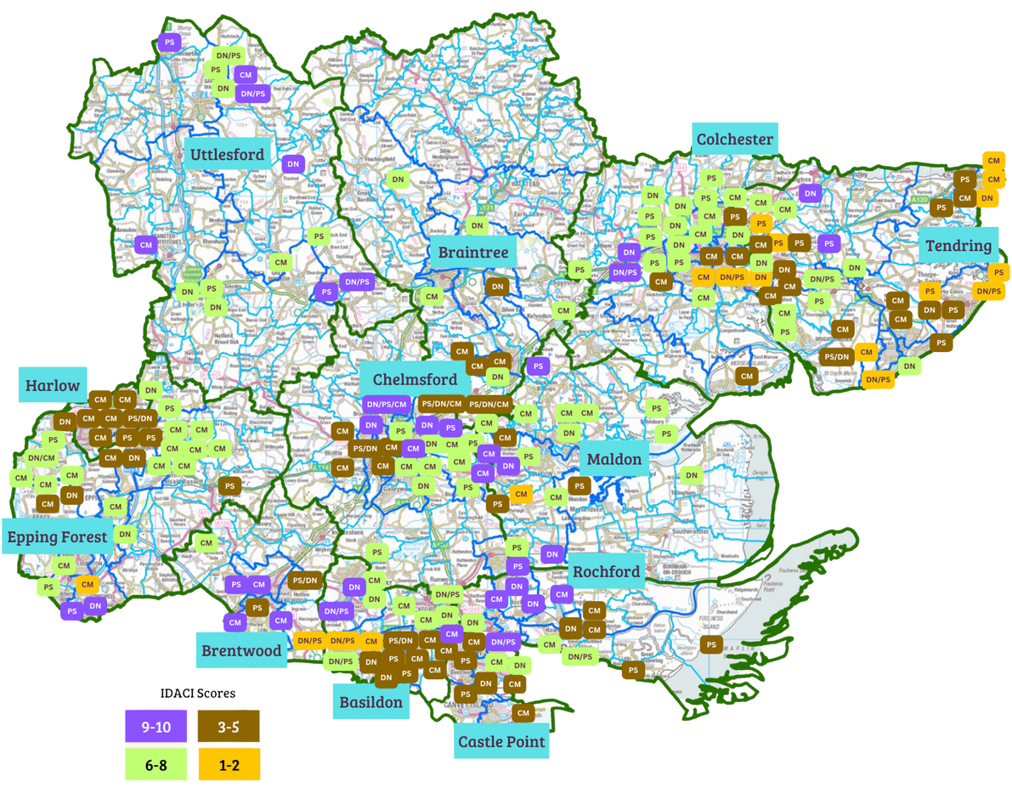



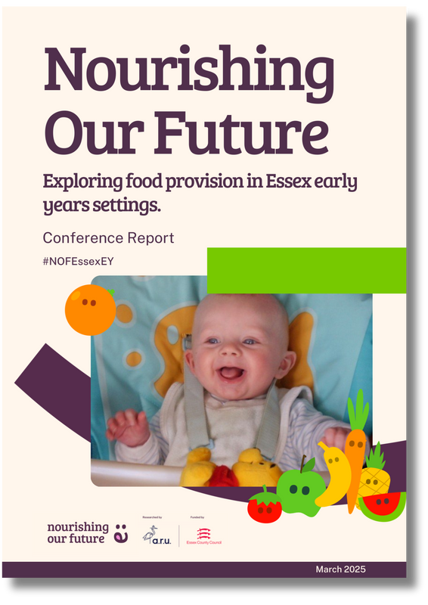

Introduction
6 months
Challenges & Opportunities
Project duration
201 survey responses
Food on the agenda
Representing 207 settings
Food education
7 workshops
Training, support, guidance, resources
Online and in person
749 photos
Food and food education
Funding for food
5 parent interviews
Sensory & SEND
Phone calls
Support for Parents
94 childminders
58 Day Nurseries
67 Preschools
5 Parents
www.nourishingourfuture.co.uk

Slide 4







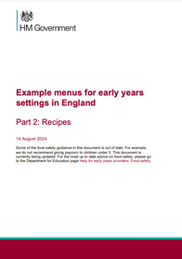

Requirements and Guidance
Nutrition and Portion Size
Food Environment
Food
Inclusivity
Food
Education
Sustainable Food
81%
97%
Day Nurseries
79%
Food Policy
Do not charge or charge a voluntary fee for food
Commercial Kitchen
90%
‘prefer something more visual, broken down into themes, with quick snack ideas and recipes linking to the food groups.’
Childminders
‘Allergies can be a big challenge as free from food is more expensive.’
Domestic Kitchen
57%
Preschools
‘Children are encouraged to bring in ‘sharing snacks’ which works well because it is continually brought in and is cost effective.’
Basic Prep Facilities
Challenges and Barriers
41%
58%
‘We never really talk about food in early years’
Parent provided
Food preferences
33%
49%
Setting provided
Cost
‘It’s nice to have our voices heard and knwo that it’s not just us struggling - we feel isolated ‘
25%
40%
Caterer/chef
Allergies

Slide 5
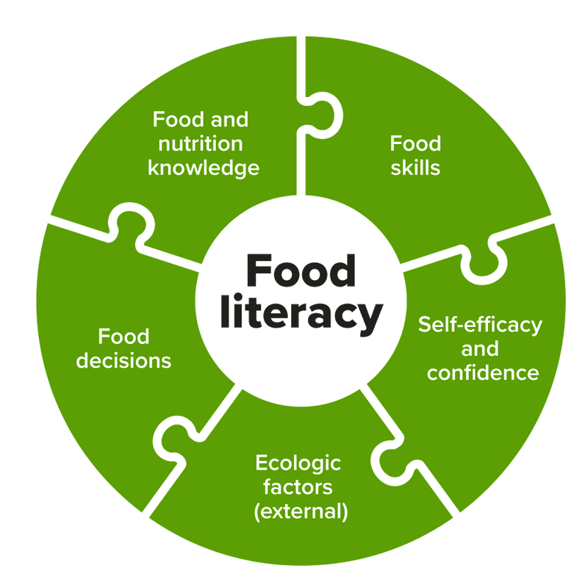
In what ways are Early Years Professionals in Essex supported to lead food literacy education?
Food
Literacy
Requirements and Guidance
Food
Education
Food literacy moves beyond just knowledge to enable informed food choices that lead to healthier futures and improved health outcomes (McManus, Pendergast and Kanasa, 2025; Ares et al, 2023).

Slide 6
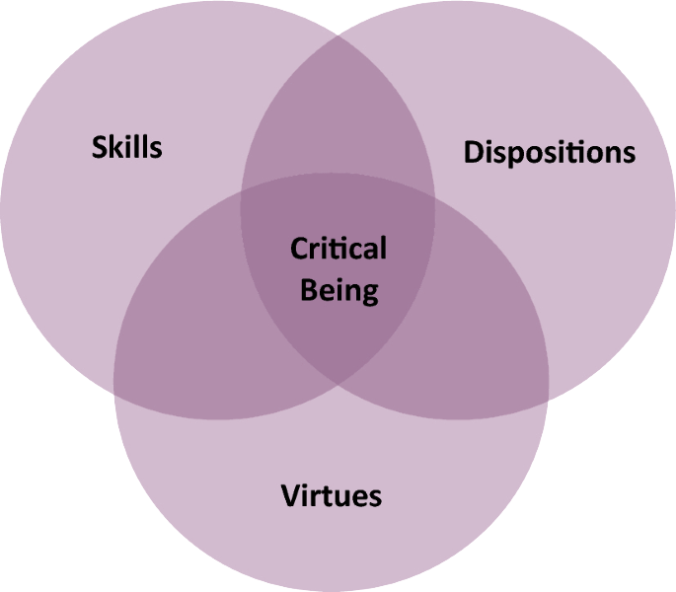
The value of professional enquiry
What is a professional enquiry?
A professional enquiry within education encompasses partnerships and participation of a range of stakeholders within a community who collaborate efficiently to deeper understand their world (Reed, 2007).
The benefits of a professional enquiry:
  Utilises stakeholders within a professional context.
  Facilitates co-production within a team and community.
  Imperative to professional practice and learning.
  Enhances understanding of the professional context.
  Creates an opportunity to reflect.
A Model for Understanding and Expanding the Scope of Critical Thinking (Normile, 2025)

Slide 7
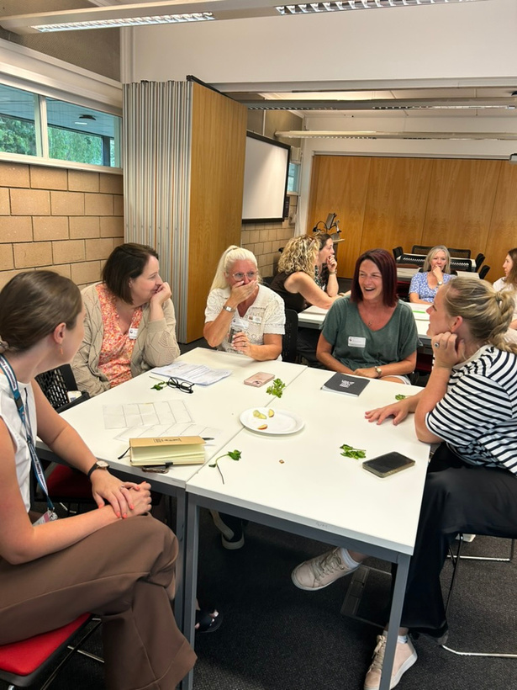


Seminal and contemporary literature
Professional dialogue
R|R
Methods
used in this professional enquiry
This provides critical and relevant perspectives and experiences within practice.
Theoretical perspectives augment professional dialogue and reflection to discuss and conclude the key findings.
Analysis of policy and guidance
Reflection
Including collaborative reflection on research and practice through Brookfield’s (1995) Four Lenses.
This enables an appreciative understanding of support available in the sector.
Notes:
To answer the questions, this enquiry utilises seminal and contemporary literature which spans from the early twentieth century to current practice. Analysing scholarly conventions and policy guidance enables an appreciative understanding of support available in the sector. Findings to this enquiry are enhanced by using ethical reflection and professional dialogue which critically examines how support is provided to EYPs in Essex. Theoretical perspectives augment professional dialogue and reflection to discuss and conclude the key findings.
Reed (2007) underpins how enquiries that encompass social and human interaction can be meaningful in the transformation process of entire communities. Reflective writing in this enquiry involves an ethical interpretation of professional experiences which encourage a perspective-taking approach to delivering actions to better support the sector (Shapiro, 2022).

Slide 8
Who provides support to Early Years Professionals in Essex to lead food literacy education activities?
Model of enquiry and questions
Define
Discover
the enquiry using scholarly conventions and reflections and defining the use of professional enquiry through a personal lens.
examples of excellence and achievements through literary texts and reflection through collective lenses.
How is support provided to Early Years Professionals in Essex to lead food literacy education?
Enquiry question:
In what ways are Early Years Professionals in Essex supported to lead food literacy education?
Dream
Deliver
and envision the need for a better future for the sector through professional dialogue and collective reflection.
the support and reflect on the outcomes.
Design
The Appreciative Inquiry model involves the exploration of what there is or has been and how this can translate into best practice (Hayes, 2021).
and co-construct the future through a collective reflection and collegial leadership.

Slide 9
Model of reflection: Brookfield’s (1995) Four Lenses
In this enquiry process, the disposing of competencies such as intellectual empathy through Brookfield’s (1995) Four Lenses to portray intellectual humility through the distinguishing of beliefs (Paul and Elder, 2008).
Personal
Community
Reflect my own professional experiences of working closely with the sector, uncovering how my own experiences have shaped this enquiry (LaFrance, 2018).
Encompasses the perspectives of EY professionals in Essex with an overarching view of their agency (Drew, Priestley and Michael, 2015).
Peer
Theoretical
Critical conversation tool to describe experiences of colleagues and consider their multidisciplinary expertise (Brookfield, 2017).
Reflect on the bigger picture through providing theoretical conventions and reflections (Brookfield, 2017).

Slide 10



Stage 1: Defining the value of enquiry using scholarly conventions and personal reflection
NOF showcased the inspiring work early years professionals in Essex are doing to support and enhance children’s food and nutrition education learning. Despite their inspiring efforts, NOF uncovered challenges and barriers that call for further support in the sector.
1 in 5 children aged 4-5 live with overweight or obesity
14% of 5 yr olds have tooth decay
Empowering and supporting early years professionals as leaders in food literacy education positions them as key participants in promoting the healthiest futures for our youngest generation of children (Redvers et al, 2024).

Slide 11
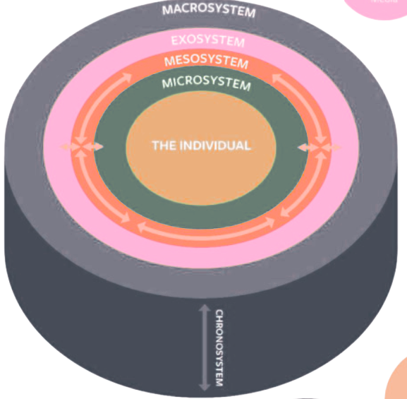






Stage 2: Discovering examples of excellence and achievements through literary texts and reflection through collective lenses
The adapted Bronfenbrenner (1979) Ecological Systems Theory, shifted the perspective to reflect on the experiences of EYPs in Essex, enabling discoveries to be representable to the local EY sector.
Department for Education (DfE)
Ministerial department of government
Local authority and university partnership
Local interactions
Setting leaders and managers
Workplace context

Slide 12





Stage 3: Dreaming and envisioning the need for a better future for the sector through professional dialogue and peer reflection
Food literacy education can be viewed as a rhizomatic learning process for early years professionals, as they develop meanings and combine connections through their relational experiences (Cliffe and Solvason, 2016).
The role of food literacy and education needs to be more widely recognised in early years CPD.
Myself & my cook have always looked out for food courses & never find anything.
Need for an established platform which collates guidance and resources for all aspects of EY food and nutrition, including food literacy education.
Put off due to the length of documents, prefer something more visual, broken down into themes.
National guidance
and frameworks
Leadership
CPD
Onboarding further professional opinions from a practice perspective will strengthen relevance.
Extend nutrition education to the home environment.

Slide 13
Stage 4: Utilising a collegial leadership approach to design and co-construct the future through a collaborative reflection
Collegial leadership is strongly advocated by stakeholders as a key approach for the delivery of an initiative (Silva et al, 2022), enabling professional voices to be generated. Key characteristics of collegial leadership have been utilised to frame the multiple stakeholders’ viewpoints (Crawford, 2012; Bush, 2016).
Interaction of leaders
Consensual decision making
The participatory process between leaders enables the designing of the support to be collectively evaluative to enhance organisational learning (Chadd, Malik and Kapiliasharmi, 2025).
A reflexive approach (Chadd, Malik and Kapiliasharmi, 2025) enables all professionals to reflect on their experiences and discuss possible solutions through weekly meetings and workshops.

Slide 14



Stage 5: Delivering the support and reflecting on the outcomes
A strength of using the AI model is its cyclical structure which allows for the redefining of the enquiry (Arrington, 2022).
The support was delivered through a partnership across organisations and the community of early years professionals in Essex.
Dewey (1916) stated how education is not just the telling individuals, it is the active construction of knowledge through processing.
Delivering this support was performed through the active collaboration and creating interactive learning processes.
Define
Discover
the enquiry using scholarly conventions and reflections and defining the use of professional enquiry through a personal lens.
examples of excellence and achievements through literary texts and reflection through collective lenses.
Deliver
Enquiry question:
In what ways are Early Years Professionals in Essex supported to lead food literacy education?
Dream
the support and reflect on the outcomes
and envision the need for a better future for the sector through professional dialogue and collective reflection.
Design
and co-construct the future through a collective reflection and collegial leadership.

Slide 15
Discussing key findings
In what ways are Early Years Professionals in Essex supported to lead food literacy education?
Community engagement is the overarching approach that supports early years professionals in Essex which encompasses the relationships between stakeholder and the development of interventions, programs and support (Redvers et al, 2024).
Who provides support to Early Years Professionals in Essex to lead food literacy education?
How is support provided to Early Years Professionals in Essex to lead food literacy education?
Relational community engagement evidences how support for early years professionals across Essex and arises through three system levels: micro, meso and macro (Redvers et al, 2024).
Support for early years professionals is seen as an assemblage of stakeholders, resources and leadership strategies which come together to improve the informed knowledge and capacity to lead food literacy education (Nail, 2017).

Slide 16
Conclusion and implications
The delivered support for early years professionals in Essex to lead food literacy education is provided at multi level in a non-structured, rhizomatic way (Deleuze and Guattari, 2008; Mc Donnell Gillic, Kennedy and Kearney, 2025).
Empowering and supporting early years professionals in Essex so they feel confident to lead food literacy education, positions us one step closer to lowering health inequalities for our youngest generation of children (Warren, Williams and Knai, 2022 and Ares et al, 2023).

Slide 17
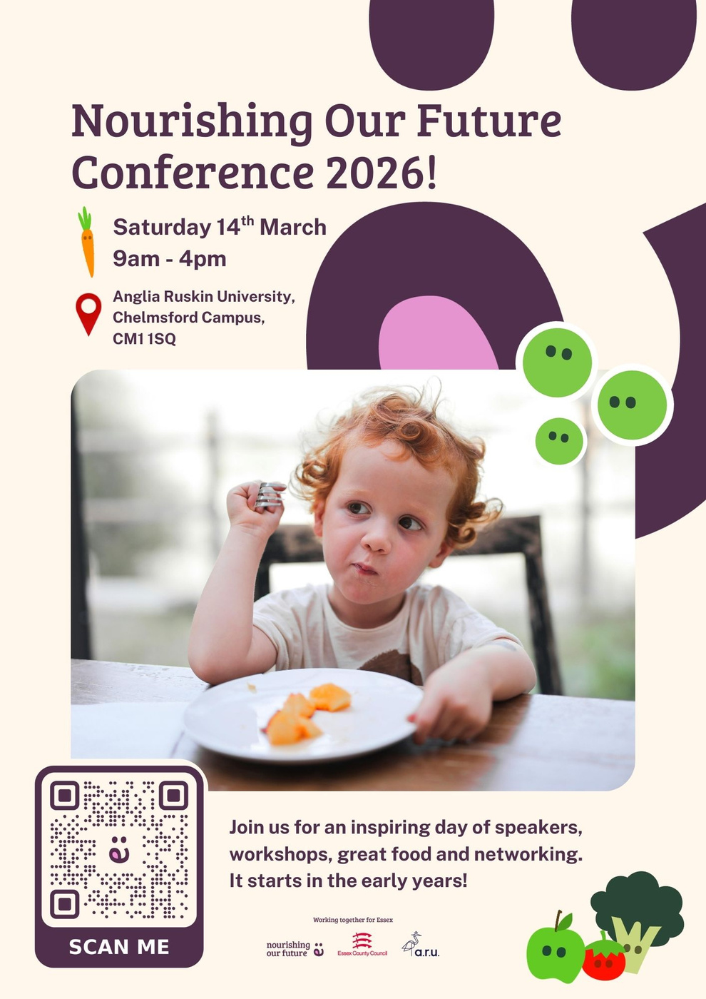
Contacts
mitzi.harris1@aru.ac.uk
nof@aru.ac.uk
thenofaward@essex.gov.uk
https://nourishingourfuture.co.uk/

Slide 18
References
Ares, G., Rosso, S., Mueller, C., Phillipe, K., Pickard, A., Nicklaus, A., Kleef, A., Varela, P. (2023) ‘Development of food literacy in children and adolescents: implications for the design of strategies to promote healthier and more sustainable diets.’ Nutrition Reviews, 82(4). Available at: https://doi.org/10.1093/nutrit/nuad072. (Accessed 30 September 2025)
Arrington, L.A. (2022) ‘The 5D Cycle for Health Equity: Combining Black Feminism, Radical Imagination, and Appreciative Inquiry to Transform Perinatal Quality Improvement’, Journal of Midwifery & Women’s Health, 67(6). Available at: https://doi.org/10.1111/jmwh.13418 (Accessed 13 November 2025)
Brookfield, S. (2017) Becoming a Critically Reflective Teacher. 2 edn. Jossey-Bass.
Bronfenbrenner, U. (1979) The ecology of human development. Cambridge, MA: Harvard University Press.
Bush, T. (2016) ‘Collegiality and professional learning communities.’ Educational Management Administration & Leadership, 44(6), 871–874. https://doi.org/10.1177/1741143216663993(Accessed 1 November 2025)
Chadd, K., Malik, M. and Anuj Kapilashrami (2025) ‘Operationalising participatory action research to evaluate early years’ population health services’, BMC Public Health, 25(1). Available at: https://doi.org/10.1186/s12889-025-22183-8. (Accessed 10 November 2025)
Crawford, M. (2012) Solo and distributed leadership: Definitions and dilemmas. Educational Management Administration & Leadership, 40(5), 610–620. https://doi.org/10.1177/ 1741143212451175 (Accessed 1 November 2025)
Cliffe, J., and Solvason, C. (2016) Using Rhizomatic Thinking in Early Childhood Pedagogy to Avoid Making Other into Same. Available at: https://eprints.worc.ac.uk/4581/1/Reflections-Cliffe-and-Solvason.pdf (Accessed 1 October 2025)
Deleuze, G., & Guattari, F. (1994) What is philosophy?. London: Verso.
Dewey, J. (1916) Democracy and education: An introduction to the philosophy of education. Macmillan Publishing
Drew, V., Priestley, M. & Michael, M.K. (2016) ‘Curriculum Development Through Critical Collaborative Professional Enquiry.’ Journal of Professional Capital and Community, 1 (1), 92-106. Available at: https://doi.org/10.1108/JPCC-09-2015-0006(Accessed 12 November 2025)
Hayes, J. (2021) The Theory and Practice of Change Management. 6 edn. Red Globe Press.
Lafrance, T. (2018) ‘Exploring the intrinsic benefits of nursing preceptorship: A personal perspective’, Nurse Education in Practice, 33(1), pp. 1–3. Available at: https://doi.org/10.1016/j.nepr.2018.08.018 (Accessed 12 November 2025)
Gillic, A.M.D., Kennedy, A. and Kearney, J.M. (2025). Food literacy in preschool-aged children - influencing factors, programmes, and outcomes: A scoping review. Eating Behaviors, [online] 59, p.102033. doi:https://doi.org/10.1016/j.eatbeh.2025.102033.
McManus, S., Pendergast, D. and Kanasa, H. (2025) ‘The Intersection Between Food Literacy and Sustainability: A Systematic Quantitative Literature Review.’ Sustainability, 17(2), p. 459. Available at: https://doi.org/10.3390/su17020459. (Accessed 5 November 2025)
Nail, T. (2017) ‘What is an Assemblage?’ SubStance, 46(1), pp.21–37. Available at: doi:https://doi.org/10.3368/ss.46.1.21. (Accessed 23 November 2025)
Normile, I. (2025) ‘A Model for Understanding and Expanding the Scope of Critical Thinking.’ Stud Philos Educ 44, 283–303 Available at: https://doi.org/10.1007/s11217-024-09976-x (Accessed 15 November 2025)
Paul, R., and Elder, L. (2008) Critical thinking: The nuts and bolts of education. Optometric Education
Reed, J. (2007) Developing research questions and goals with communities. In Developing research questions and goals with communities (pp. 91-110). SAGE Publications, Inc. Available at: https://doi.org/10.4135/9781412983464.n5 (Accessed 1 October 2025)
Redvers, N., Odugleh-Kolev, A., Paula Cordero, J., Zerwas, F., Zitoun, NM., Kamalabadi, YM., Stevens, A., Nagasivam, A., Cheh, P., Callon, E., Aparicio-Reyes, K., and Kubota, S. (2024) ‘Relational community engagement within health interventions at varied outcome scales.’ PLOS Glob Public Health 4(6) Available at: https://doi.org/10.1371/journal.pgph.0003193 (Accessed 15 November 2025)
Warren, E., Williams, L. and Knai, C. (2022) ‘The “Cinderella sector”: The challenges of promoting food and nutrition for young children in early years’ settings in England’, Ecology of Food and Nutrition, 61(5), pp. 1–19. Available at: https://doi.org/10.1080/03670244.2022.2073353 (Accessed 25 September 2025)

