Slide 1

The Right Support at the Right Time
Understanding the Barriers to Early Years Support in Northern Ireland
Exploring what works, what doesn’t and how we move forward
Dr Aisling Hylands

Slide 2
Session Overview
Study snapshot: 3 data strands (Stakeholders, Workforce and Parents)
Understand current strengths in early intervention in NI
Identify systemic barriers and their impact
Explore recommendations for change
Reflect on implications for professional practice

Slide 3

Why Early Intervention Matters
First three years = foundation for lifelong health and wellbeing
Secure relationships drive early brain development
Cost of late intervention: £536 million annually in NI

Slide 4
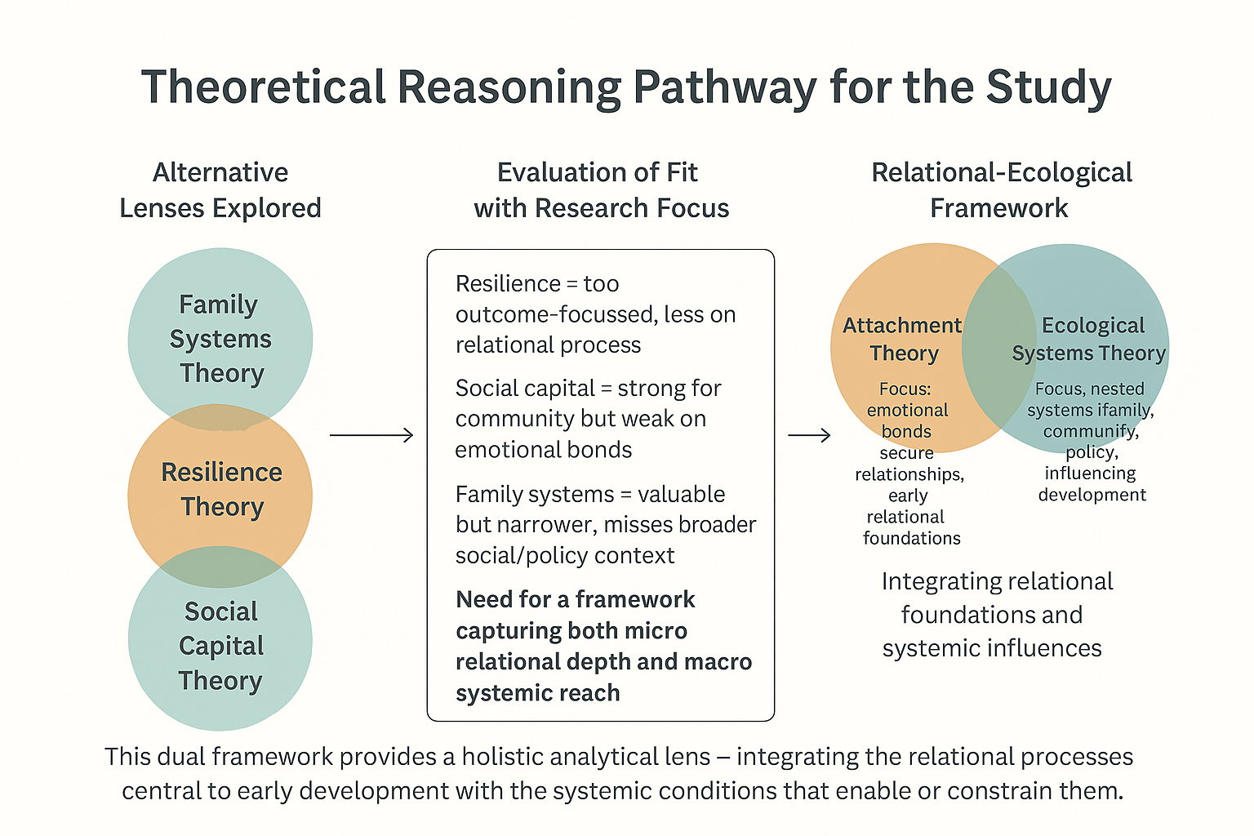
Establishing a Theoretical Framework

Slide 5
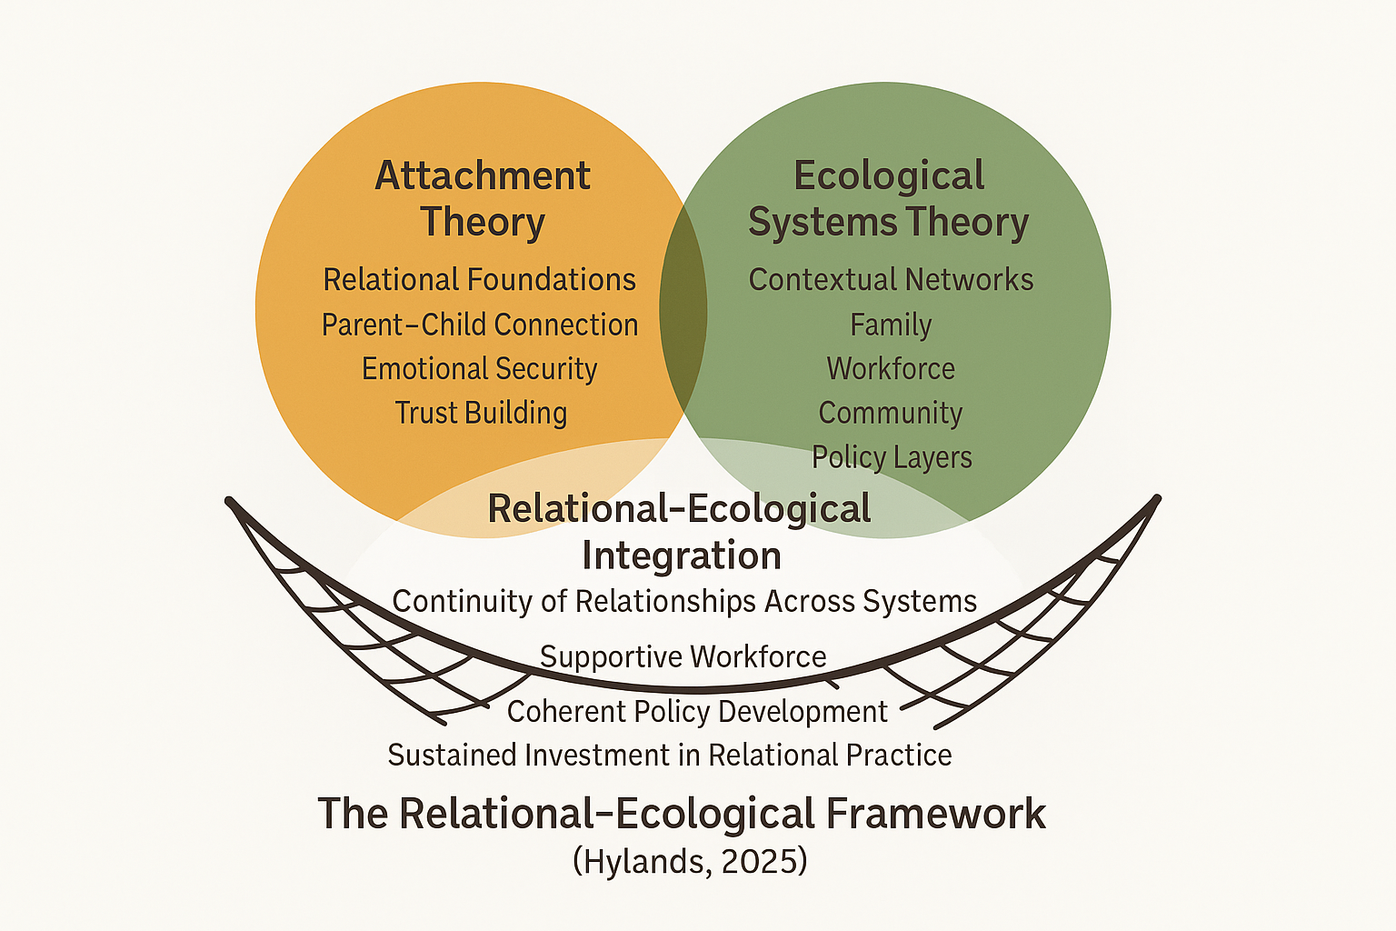
Relational-Ecological Framework

Slide 6
A Fractured System
Systemic barriers:
Fragmented services (“silos”)
Postcode lottery of access
Inflexible, short-term funding
Reactive, not preventative approaches

Slide 7
The Workforce Crisis
High caseloads and emotional strain
Burnout and turnover
Lack of professional development and supervision
Under-recognised professional status

Slide 8
The Human Cost
Impacts on parents and children:
Long waiting lists for mental health support
Mothers overwhelmed, gaps in postnatal care
Fathers “invisible” in services
Children bear the ultimate cost — disrupted attachment

Slide 9
What the data tells us
“Short-term contracts and funding are a real issue. You spend time building relationships with vulnerable families, but when contracts end, you lose the experienced staff who those families rely on, which can disrupt their progress.”
(Stakeholder participant)
“We are in a brilliant position to be able to go in and support these families early…when you’ve got the time and you’re seeing a family regularly, they open up more.”
(Health visitor participant)
Relational continuity is central: secure parent–child attachment depends on caregiver mental health and sustained practitioner relationships.
Workforce fragility undermines prevention: short-term funding, low pay and high caseloads reduce relational time and drive turnover.
Access and equity gaps: postcode variation and long waiting lists mean similar needs receive very different responses.

Slide 10
Priority implications — what to do next
Protect
Protect relational time: reduce caseloads or ringfence minutes for relational visits and follow‑up.
Stabilise
Stabilise the workforce: move to longer funding cycles, improve pay, and invest in CPD and supervised mentorship.
Tackle
Tackle access inequities: scale community early‑intervention capacity and improve proactive signposting across postcodes.
“We’ve had incredible staff who’ve built relationships with families, and then they leave because we just can’t offer them the security they need. The turnover is really damaging.” (Stakeholder)

Slide 11

Moving Forward: Three Pillars for Reform
Sustained, Flexible Investment
Integrated, Child-Centred Strategy
Workforce Professionalisation and Support

Slide 12

Final Reflections and Implications
Early support works best when it is relational, consistent and trusted
Universal services are valued, but increasingly stretched
Findings point to the need for a complementary relational role that:
Bridges health, early education and community support
Strengthens continuity rather than replacing existing services
Northern Ireland context matters
Post-conflict legacy, devolved governance and service fragmentation
Makes relational continuity particularly critical
A timely moment for change
Early Years Strategy progressing
Workforce alignment remains essential

Slide 13
Thank You For Listening

