Slide 1
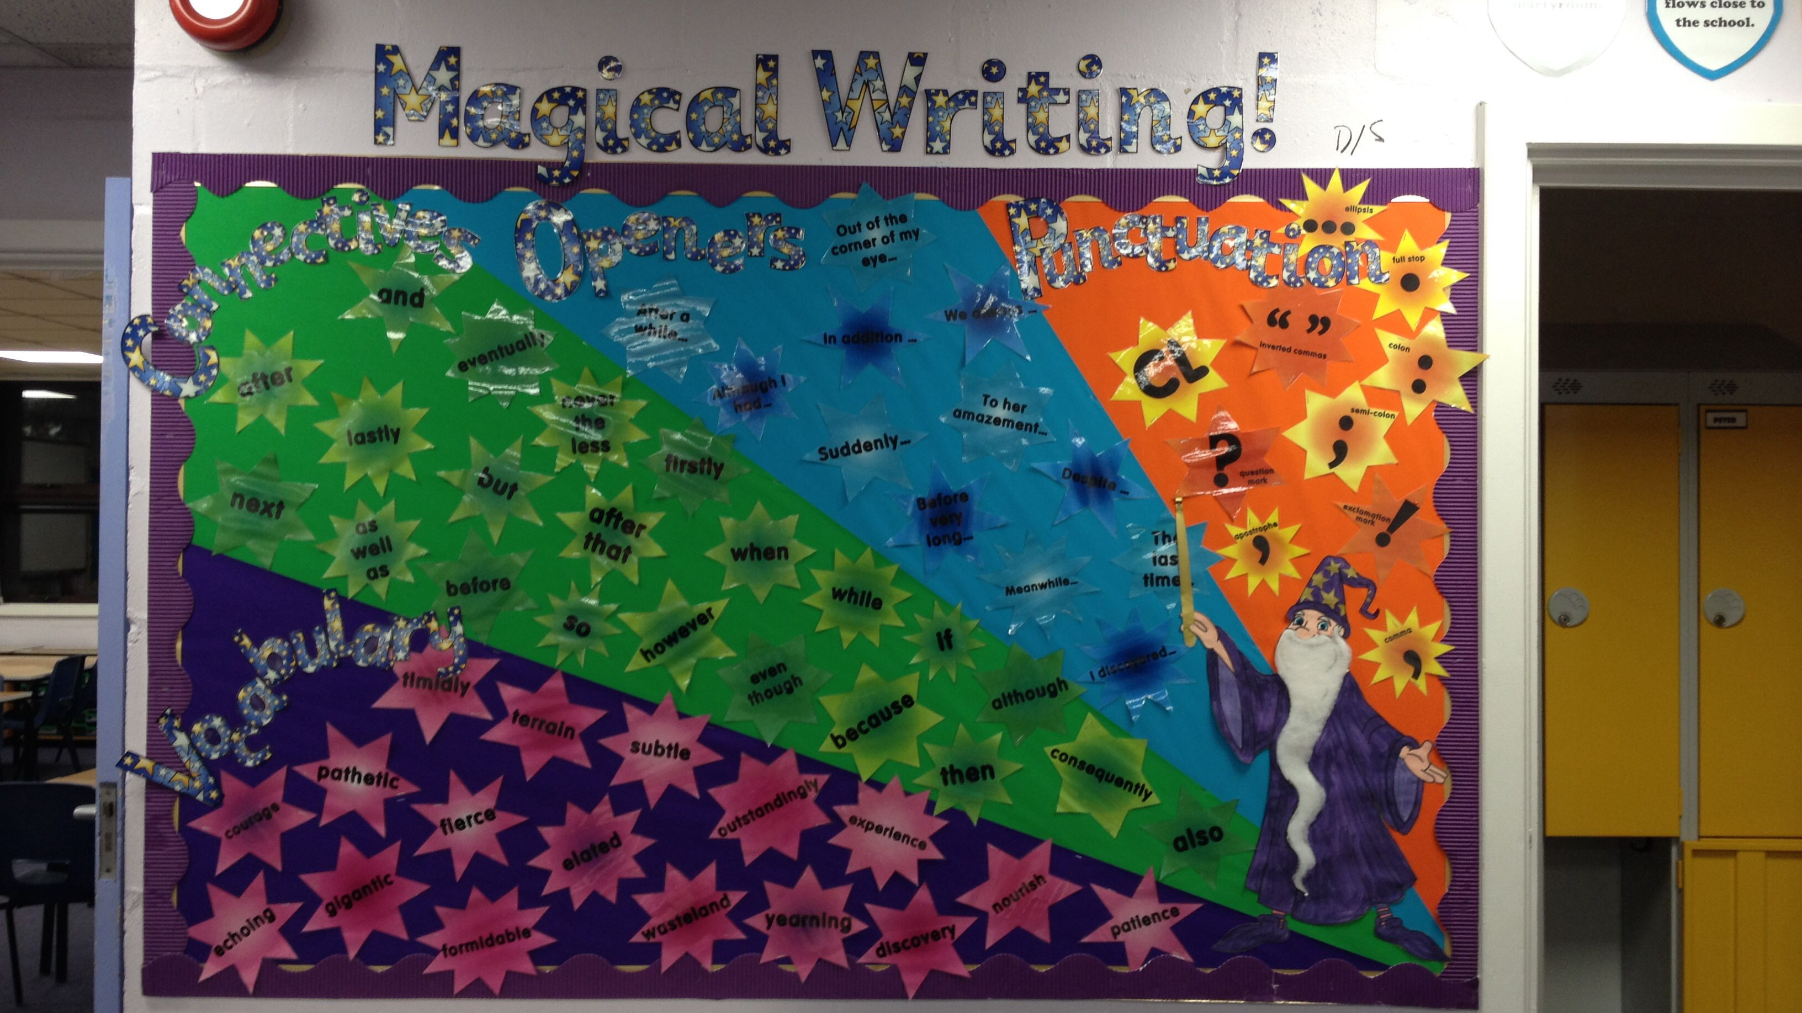
How Effective Are Classroom Displays in Supporting Learning for Reception and Year 6 Children?
Evaluating visual aids to enhance student learning outcomes
Notes:
---

Slide 2
Introduction
Notes:
---
This slide references information from the following file: https://bucksnuniversity-my.sharepoint.com/personal/borbala_kenez-burns_bucks_ac_uk/Documents/Microsoft%20Copilot%20Chat%20Files/Emma%20-%20research%20proposal.docx
Research Aim and Rationale

Slide 3
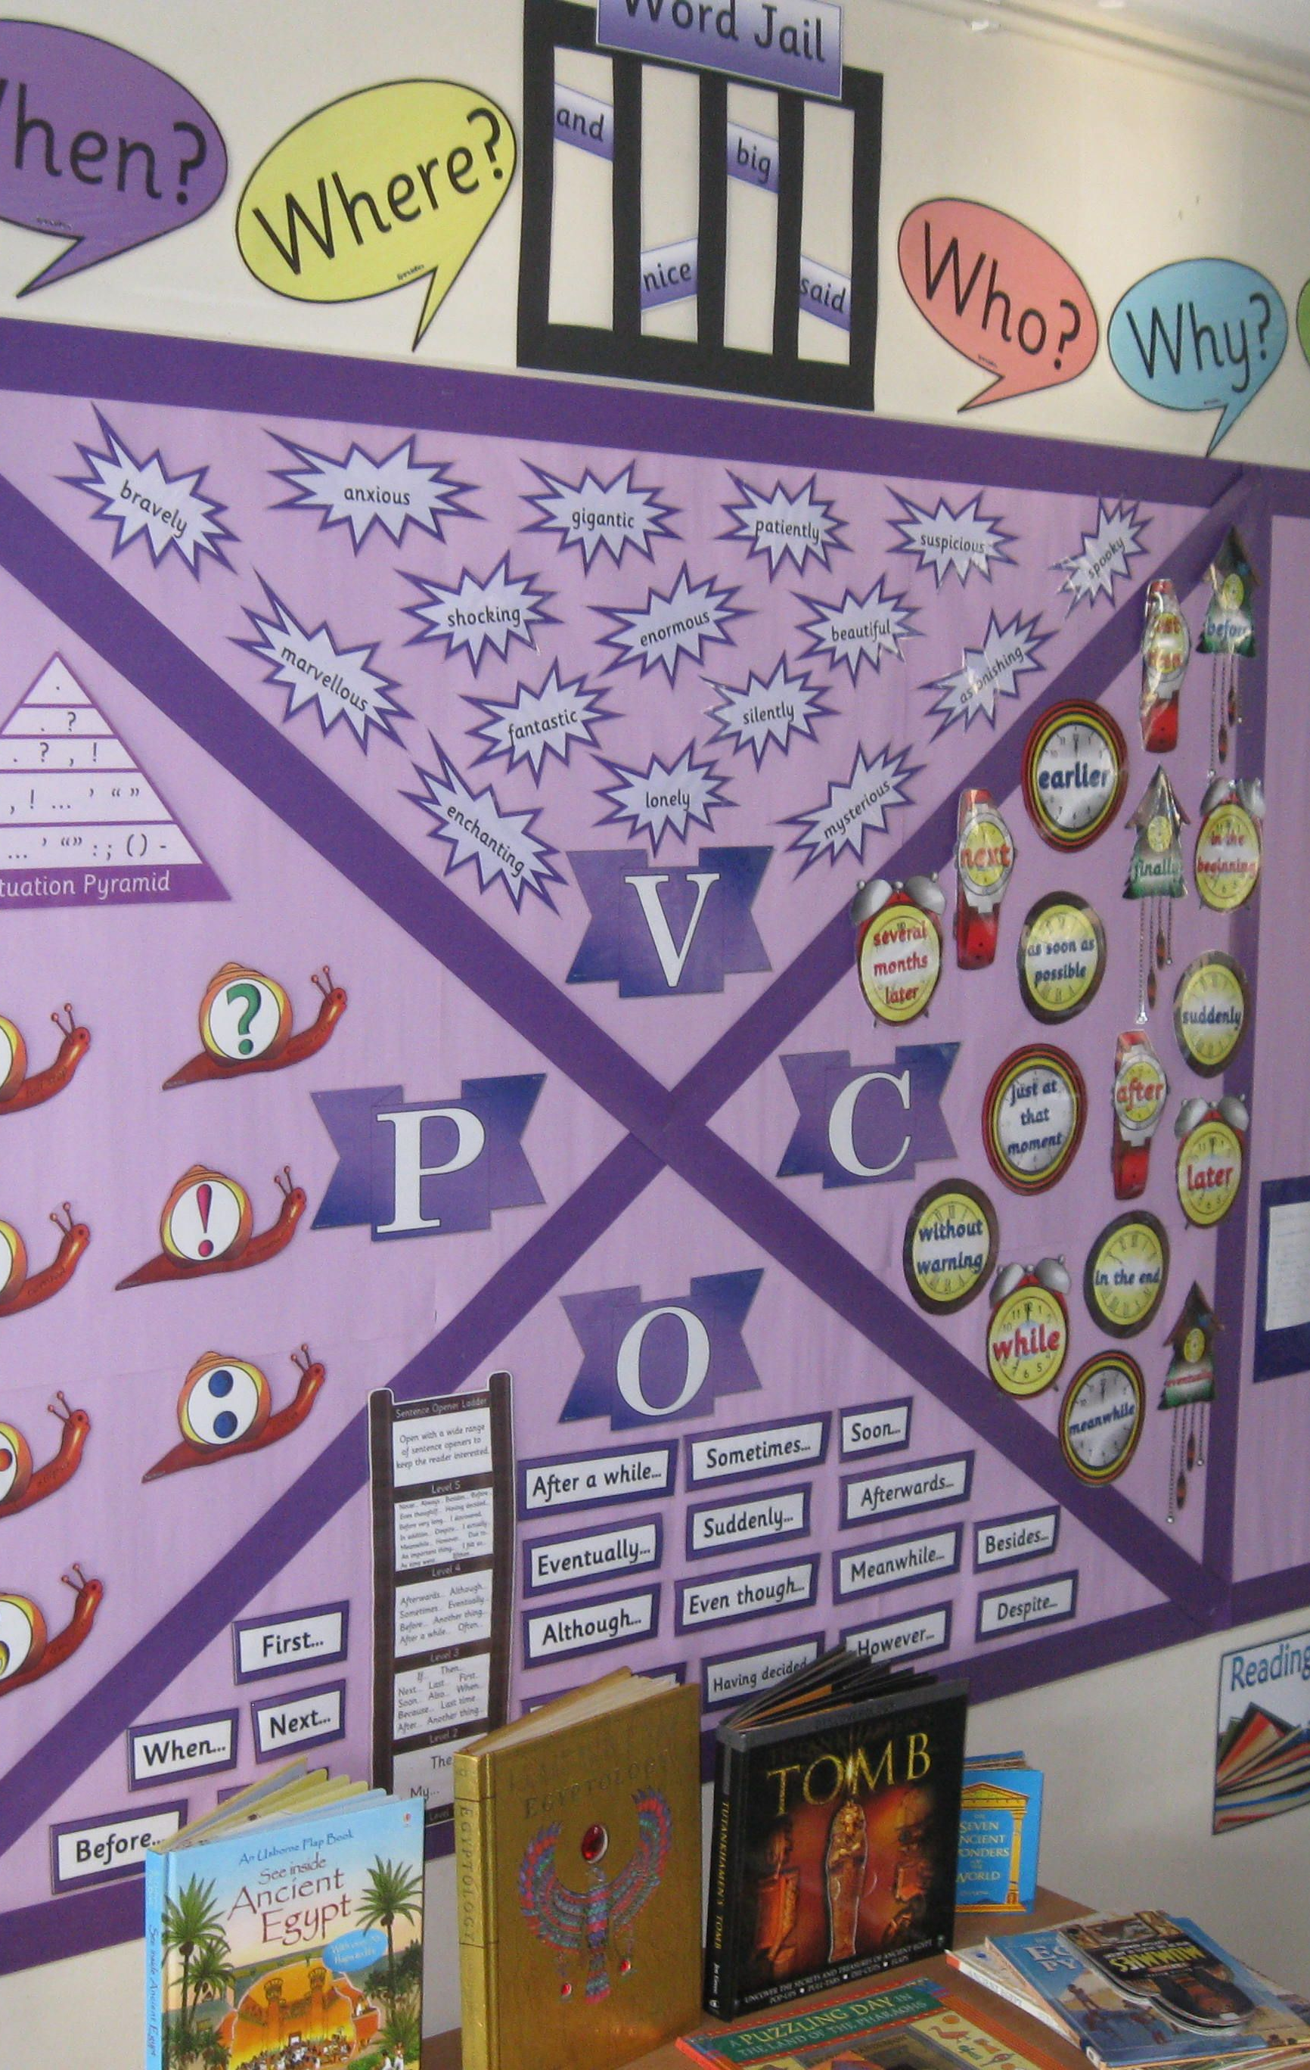
Research Aim and Rationale
Study Objective.
Investigate how classroom displays affect learning for Reception and Year 6 children. (Cooper, 1996)
Rationale for Research. (Barrett et al., 2015)
  Research motivated by educator’s experience and observations, especially with children facing dyslexia challenges.
Research Question
  How Effective Are Classroom Displays in Supporting Learning for Reception and Year 6 Children?
Goal of Study
  Inform best practices for designing supportive and inclusive classroom environments. Explore if classroom displays truly support learning or are just decorative elements
Notes:
---
This slide references information from the following file: https://bucksnuniversity-my.sharepoint.com/personal/borbala_kenez-burns_bucks_ac_uk/Documents/Microsoft%20Copilot%20Chat%20Files/Emma%20-%20research%20proposal.docx
The research aims to investigate the effectiveness of classroom displays in supporting learning for Reception and Year 6 children. Classroom displays are widely used in educational settings to enhance engagement and provide visual stimulation, yet their actual impact on learning outcomes remains debated. The rationale for this study stems from the researcher’s extensive experience in education and personal observations, including challenges faced by children with dyslexia who may find displays distracting rather than helpful. This personal connection underscores the importance of exploring whether displays genuinely support learning or serve primarily as decorative elements. The research question guiding this study is: How effective are classroom displays in supporting learning for Reception and Year 6 children? By addressing this question, the study seeks to inform best practices for creating classroom environments that are both supportive and inclusive.

Slide 4
Literature Review
Notes:
---
This slide references information from the following file: https://bucksnuniversity-my.sharepoint.com/personal/borbala_kenez-burns_bucks_ac_uk/Documents/Microsoft%20Copilot%20Chat%20Files/Emma%20-%20research%20proposal.docx
Key Themes and Gaps

Slide 5
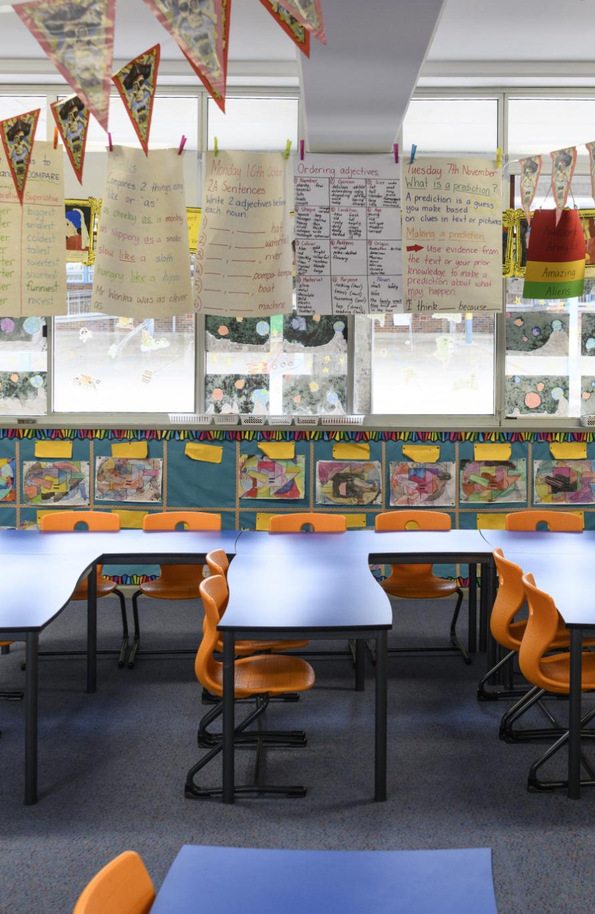
Key Themes and Gaps
Benefits of Classroom Displays. (Eckhoff, 2019)
  Displays foster engagement, reinforce key concepts, and promote student pride and ownership in learning. (Strong-Wilson & Ellis, 2007)
Drawbacks and Challenges. (Lewin-Benham, 2015)
  Overly decorated environments may distract students and cause reliance on visual cues, limiting critical thinking. (Thomson et al., 2007)
Controversies on Color and Design. (Fisher et al., 2014)
  Vibrant colors may stimulate engagement but can also overwhelm and reduce students’ focus. (Gaines & Curry, 2011)
Gaps in Learning Outcome Evidence. (Maxwell, 2000)
  Limited research exists on the direct impact of displays on learning outcomes across age groups, calling for further study. (Didau, 2013)
Notes:
---
This slide references information from the following file: https://bucksnuniversity-my.sharepoint.com/personal/borbala_kenez-burns_bucks_ac_uk/Documents/Microsoft%20Copilot%20Chat%20Files/Emma%20-%20research%20proposal.docx
The literature reveals diverse perspectives on classroom displays. Some studies highlight their benefits, such as fostering engagement, reinforcing key concepts, and promoting a sense of ownership and pride among students. Displays can act as reflective tools for educators and showcase children’s achievements. However, other research suggests potential drawbacks, including distraction caused by overly decorated environments and the risk of students becoming overly reliant on visual cues, which may hinder independent learning and critical thinking. Contradictory viewpoints exist regarding the role of colour and design, with some arguing that vibrant colours stimulate engagement while others claim they can overwhelm and reduce focus. Despite extensive research on documentation and classroom aesthetics, there is a notable gap in evidence regarding the direct impact of displays on learning outcomes across different age groups. This gap underscores the need for further investigation to develop informed strategies for effective classroom display use.

Slide 6
Theoretical Framework
Notes:
---
This slide references information from the following file: https://bucksnuniversity-my.sharepoint.com/personal/borbala_kenez-burns_bucks_ac_uk/Documents/Microsoft%20Copilot%20Chat%20Files/Emma%20-%20research%20proposal.docx
Paradigms and Chosen Approach

Slide 7
Paradigms and Chosen Approach
Interpretivist Paradigm
This paradigm focuses on understanding subjective experiences and socially constructed knowledge in research contexts.
Contrast With Positivism
Unlike positivism, interpretivism values individual perspectives over quantitative cause-and-effect data.
Qualitative Methodology Focus
Interpretivism supports qualitative methods emphasising depth and context-specific insights in educational settings.
Notes:
---
This slide references information from the following file: https://bucksnuniversity-my.sharepoint.com/personal/borbala_kenez-burns_bucks_ac_uk/Documents/Microsoft%20Copilot%20Chat%20Files/Emma%20-%20research%20proposal.docx
The research is grounded in an interpretivist paradigm, which prioritises understanding subjective experiences and socially constructed knowledge. Unlike positivism, which relies on quantitative data and seeks cause-and-effect relationships, interpretivism focuses on individual perspectives and meanings. This approach is particularly suited to exploring how children and educators perceive classroom displays and their role in learning. By adopting interpretivism, the study aims to capture nuanced insights into personal experiences, recognising that educational practices cannot be fully understood through numerical data alone. This paradigm supports qualitative methodologies that emphasise depth over breadth, allowing for rich, context-specific findings that reflect the complexity of classroom environments.

Slide 8
Methodology
Notes:
---
This slide references information from the following file: https://bucksnuniversity-my.sharepoint.com/personal/borbala_kenez-burns_bucks_ac_uk/Documents/Microsoft%20Copilot%20Chat%20Files/Emma%20-%20research%20proposal.docx
Qualitative Approach and Methods

Slide 9

Qualitative Approach and Methods
Qualitative Methodology. (Punch, 2008)
  The study uses a qualitative approach aligned with the interpretivist paradigm for rich understanding. (Clark & Moss, 2011)
Mosaic Approach for Reception. (Ryan et al., 2014)
  Reception children engage via drawings, discussions, and observations to accommodate diverse communication. (Krueger & Casey, 2002)
Structured Focus Groups
  Year 6 children participate in structured focus groups to ensure consistent and comparable data collection.
Purposeful Sampling
  Sampling selects participants who can provide relevant insights for in-depth exploration of attitudes and behaviors.
Notes:
---
This slide references information from the following file: https://bucksnuniversity-my.sharepoint.com/personal/borbala_kenez-burns_bucks_ac_uk/Documents/Microsoft%20Copilot%20Chat%20Files/Emma%20-%20research%20proposal.docx
The study employs a qualitative methodology aligned with the interpretivist paradigm. Data will be collected through focus groups, enabling participants to share their experiences and perspectives in a collaborative setting. For Reception children, a mosaic approach will be used, incorporating drawings, discussions, and observations to accommodate diverse communication styles and developmental stages. Year 6 children will participate in structured focus groups to ensure consistency and comparability of responses. Purposeful sampling will be applied to select participants who can provide relevant insights. This methodology allows for an in-depth exploration of attitudes and behaviours, offering a comprehensive understanding of how classroom displays influence learning.

Slide 10
Ethical Considerations and Data Collection
Notes:
---
This slide references information from the following file: https://bucksnuniversity-my.sharepoint.com/personal/borbala_kenez-burns_bucks_ac_uk/Documents/Microsoft%20Copilot%20Chat%20Files/Emma%20-%20research%20proposal.docx
Ethics, Consent, and Timeline

Slide 11

Ethics, Consent, and Timeline
Ethical Compliance. (BERA, 2024)
  The study follows BERA guidelines and UNCRC principles to protect participant rights and welfare. (UNCRC, 2022)
Informed Consent and Autonomy. (Data Protection Act, 2018)
  Consent is obtained from participants and guardians, respecting children's autonomy to withdraw anytime. (Furey et al., 2010)
Data Protection and Safeguarding
  Data is securely stored and anonymised in accordance with UK legislation and safeguarding policies.
Research Timeline
  Ethical approval and consent in January, data collection in February, analysis and reporting through May 2026.
Notes:
---
This slide references information from the following file: https://bucksnuniversity-my.sharepoint.com/personal/borbala_kenez-burns_bucks_ac_uk/Documents/Microsoft%20Copilot%20Chat%20Files/Emma%20-%20research%20proposal.docx
Ethical compliance is central to this research. The study will adhere to the British Educational Research Association (BERA) guidelines and the UNCRC principles, ensuring respect for participants’ rights and welfare. Informed consent will be obtained from all participants and, where applicable, their guardians. Children’s autonomy will be respected, with the option to withdraw at any stage before data anonymisation. Data protection measures, including secure storage and anonymisation, will be implemented in line with UK legislation. Safeguarding policies will be followed throughout the process. The timeline includes ethical approval and distribution of consent forms in January 2026, data collection in February, and analysis and reporting from March to May 2026. These steps ensure transparency, integrity, and participant safety.

Slide 12
Expected Outcomes
Notes:
---
This slide references information from the following file: https://bucksnuniversity-my.sharepoint.com/personal/borbala_kenez-burns_bucks_ac_uk/Documents/Microsoft%20Copilot%20Chat%20Files/Emma%20-%20research%20proposal.docx
Anticipated Contributions

Slide 13
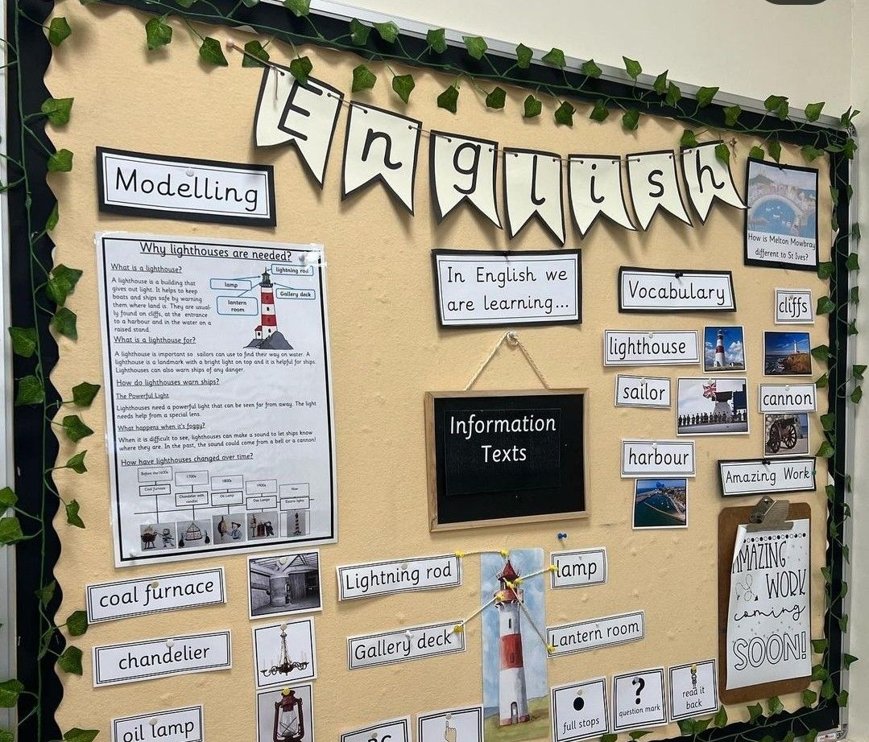
Anticipated Contributions
Supporting Developmental Learning. (Barrett et al., 2015)
  Classroom displays support learning by catering to children’s developmental stages with tailored visual content. (Eckhoff, 2019)
Balancing Stimulation and Functionality
  Effective classroom design balances visual stimulation with functionality to enhance learning without distractions.
Informing Educational Policy
  Research findings guide educational policies and strategies for inclusive, purposeful classroom display usage.
Enhancing Engagement and Accessibility
  Evidence-based display designs improve student engagement, accessibility, and academic outcomes for all learners.
Notes:
---
This slide references information from the following file: https://bucksnuniversity-my.sharepoint.com/personal/borbala_kenez-burns_bucks_ac_uk/Documents/Microsoft%20Copilot%20Chat%20Files/Emma%20-%20research%20proposal.docx
The research is expected to provide valuable insights into the role of classroom displays in supporting learning for children at different developmental stages. Findings may inform best practices for designing classroom environments that balance visual stimulation with functionality, ensuring displays serve as effective learning tools rather than distractions. The study aims to contribute to educational policy and classroom design strategies, promoting inclusive and purposeful use of displays. By addressing gaps in existing literature, the research will support educators in making evidence-based decisions that enhance engagement, accessibility, and academic outcomes for all learners.

Slide 14

Key Sources
Foundational Research Studies
  Key studies by Barrett et al., Eckhoff, and Fisher et al. provide essential insights on classroom design, documentation, and visual attention.
Guidelines and Ethical Standards
  BERA and UNCRC guidelines ensure ethical considerations and standards in educational research are upheld.
Qualitative Research Methodologies
  Literature on qualitative research methodologies supports rigorous data collection and analysis in the study.
Notes:
---
This slide references information from the following file: https://bucksnuniversity-my.sharepoint.com/personal/borbala_kenez-burns_bucks_ac_uk/Documents/Microsoft%20Copilot%20Chat%20Files/Emma%20-%20research%20proposal.docx
The presentation will conclude with a summary of key references cited in the research proposal, including works by Barrett et al. (2015) on classroom design, Eckhoff (2019) on documentation, and Fisher et al. (2014) on visual environment and attention. Additional sources include guidelines from BERA and UNCRC, as well as literature on qualitative research methodologies and ethical considerations. These references provide the theoretical and empirical foundation for the study, ensuring credibility and academic rigor.

Slide 15
References
Notes:
---
This slide references information from the following file: https://bucksnuniversity-my.sharepoint.com/personal/borbala_kenez-burns_bucks_ac_uk/Documents/Microsoft%20Copilot%20Chat%20Files/Emma%20-%20research%20proposal.docx
Key Sources

Slide 16
References
Abbott, L. & Nutbrown, C. (2011). Experiencing Reggio Emilia.
Barrett, P., Davies, F., Zhang, Y., & Barrett, L. (2015). The impact of classroom design on pupils' learning. Building and Environment, 89, 118–133.
Barrett, P., Zhang, Y., Davies, F., & Barrett, L. (2015). Clever Classrooms: HEAD Project.
Bryman, A. (2012). Social Research Methods.
Clark, A. & Moss, P. (2011). Listening to Young Children: The Mosaic Approach.
Cooper, H., Hegarty, P., & Simco, N. (1996). Display in the Classroom.
Dudek, M. (2012). Spaces for Young Children.
Eckhoff, A. (2019). Public displays of children's work as documentation. International Journal of Early Childhood, 51(1).
Enser, M. (2019). Teach Like A Writer (used to frame display reliance).
Fisher, A.V., Godwin, K.E., & Seltman, H. (2014). Visual environment and attention. Psychological Science, 25(7).

Slide 17
References
Furey, R., et al. (2010). Developing ethical guidelines for safeguarding children during social research
.
Gaines, K. & Curry, Z. (2011). Effects of colour on learning and behaviour.
Gane, M. (2006). Auguste Comte.
Johnson, B. & Christensen, L. (2000). Educational Research.
Krueger, R. & Casey, M. (2002). Designing and Conducting Focus Group Interviews.
Lewin-Benham, A. (2015). Twelve Best Practices for Early Childhood Education.
Maxwell, L.E. (2000). A safe and welcoming school.
Opie, C. (2004). Doing Educational Research.

Slide 18
Reference
Park, Y.S., Konge, L., & Artino, A.R. (2020). The positivism paradigm of research. Academic Medicine, 95(5).
Punch, K.F. (2008). Quantitative and qualitative approaches.
Ryan, K.E., et al. (2014). Focus group evidence.
Strong-Wilson, T. & Ellis, J. (2007). Environment as the third teacher.
Thomson, P., Hall, C., & Russell, L. (2007). Reading displays of primary children's work.
UNCRC (2022). Convention on the Rights of the Child.
BERA (2024). Ethical Guidelines for Educational Research.
Data Protection Act (2018).

